Slide 1
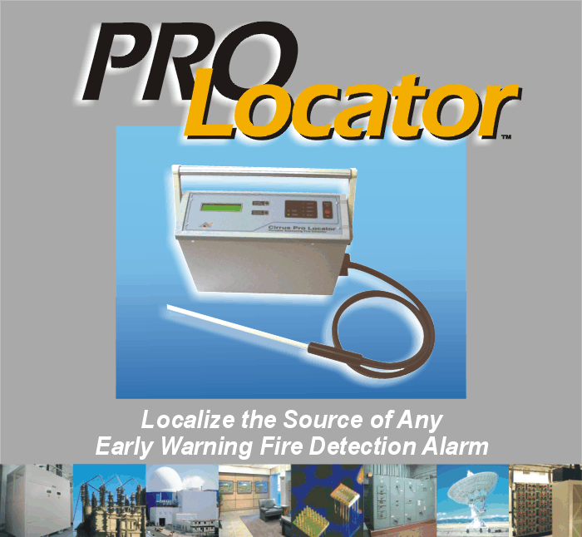
P O R T A B L E
A S P I R A T I N G D E T E C T I O N

Slide 2
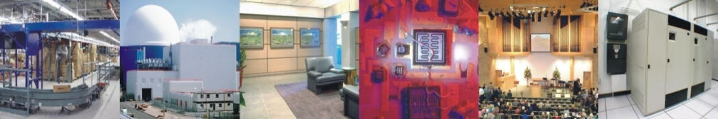
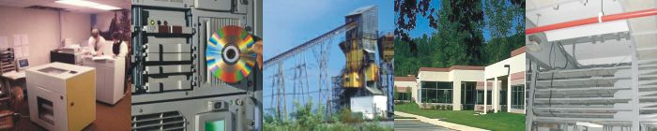
▪ Survey
▪ Isolate
▪ Identify
Portable Aspirating Fire Detection
Fires are the greatest threat to business today.
Preventing business interruption and downtime is critical

Slide 3
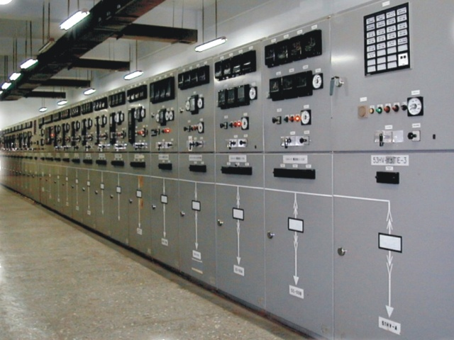
▪ Survey
▪ Isolate
▪ Identify
Portable Aspirating Fire Detection
Where’s the Fire?
Where’s the Fire?

Slide 4
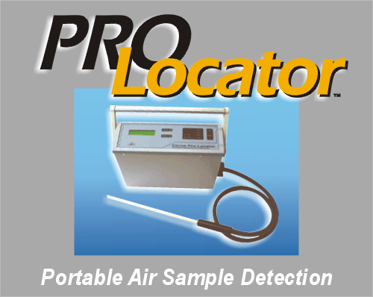
Identify the Source
Skip Video

Slide 5

Skip Video

Slide 6
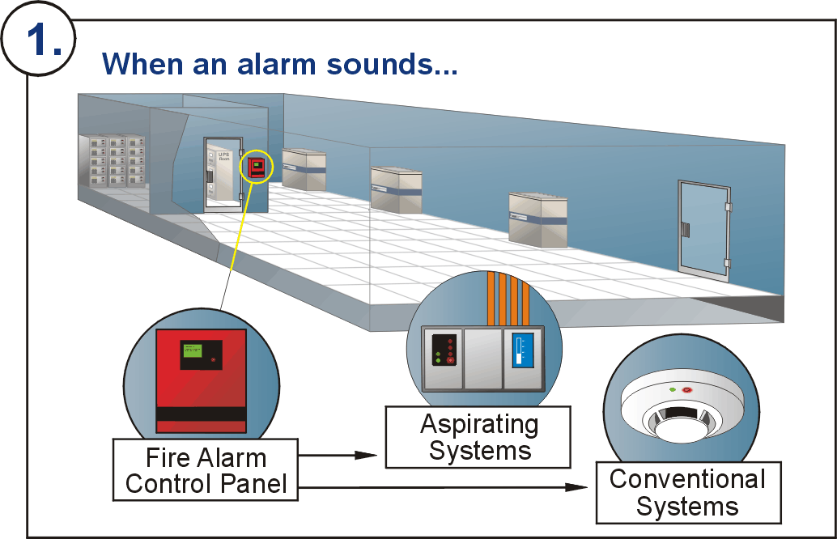
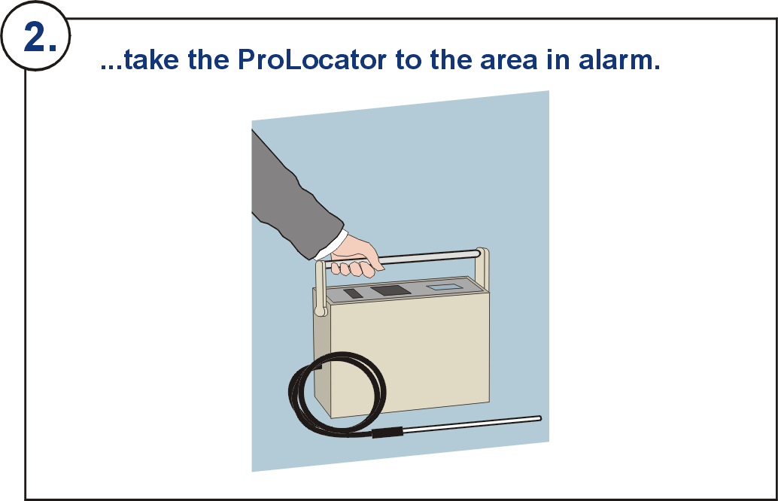
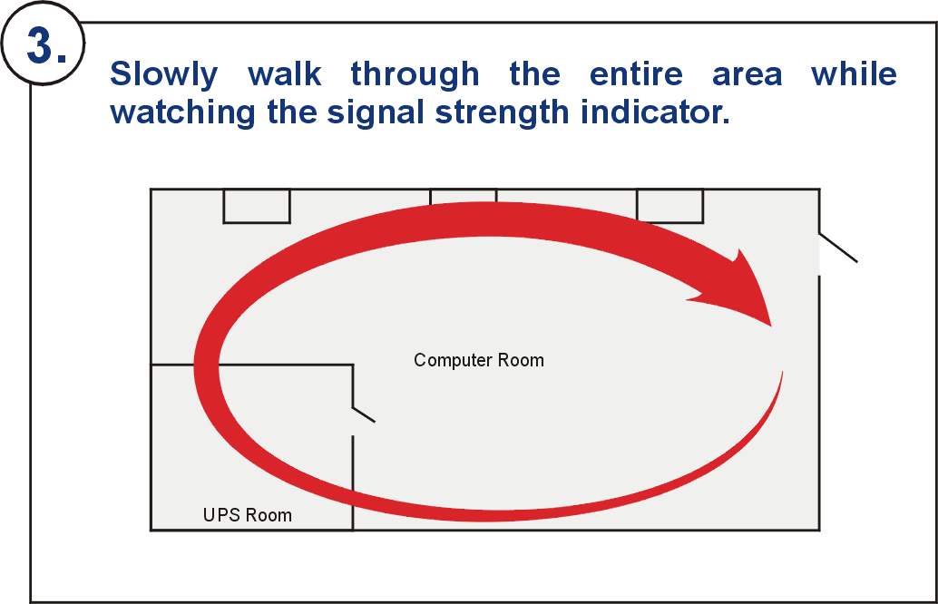
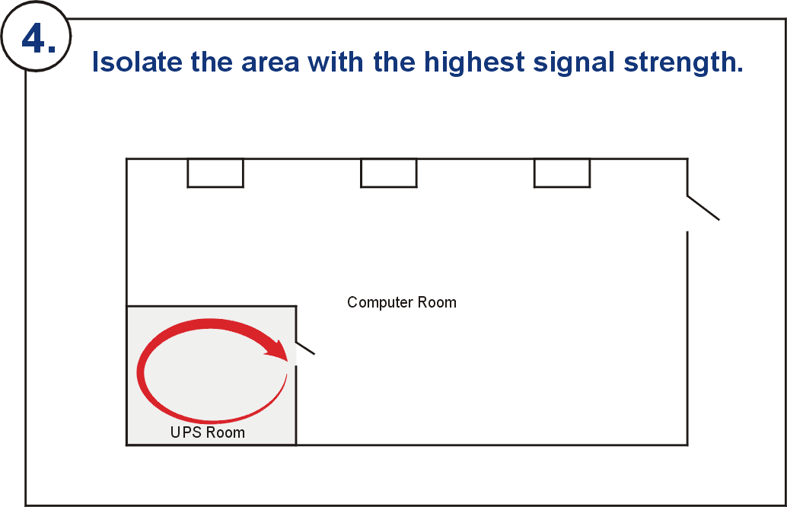
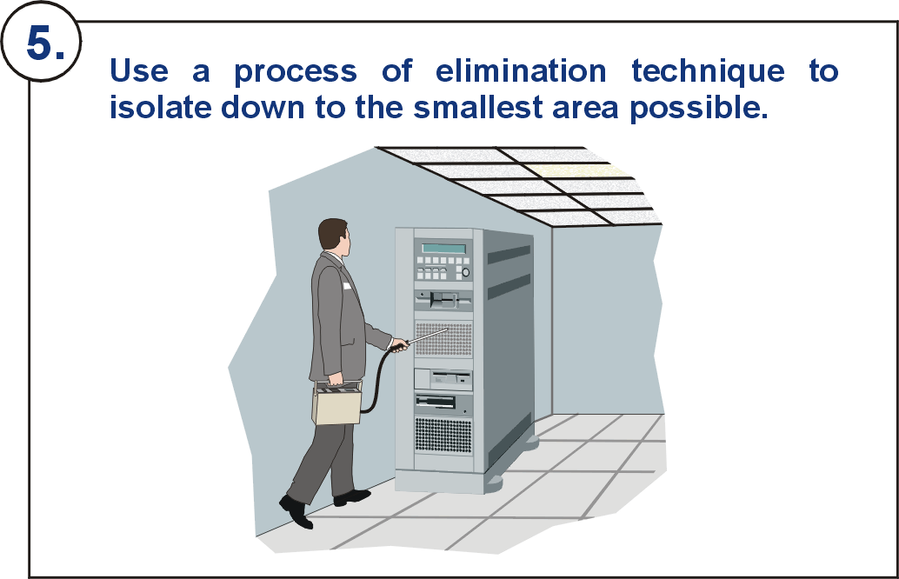

▪ Survey
▪ Isolate
▪ Identify
Portable Aspirating Fire Detection

Slide 7
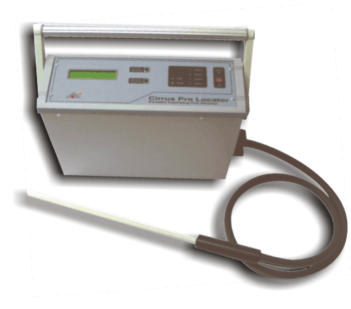
▪ Survey
▪ Isolate
▪ Identify
Portable Aspirating Fire Detection
Any “Laser Style” aspirating detector can tell you which room,
only the ProLocator can help you find where in the room!
FEATURES
Portable
■ Works with any “Laser Style” Aspirating System
■ Probe inside equipment and above drop ceilings
■ Not effected by dirt, dust, temperature or humidity
■ Completely self contained
■ Includes sampling probe and battery charger
■ Does not require any recalibration
■ Multi-speed audible tone and LED indicators to help
guide you in the right direction
■ Operates on both batteries and AC power

Slide 8
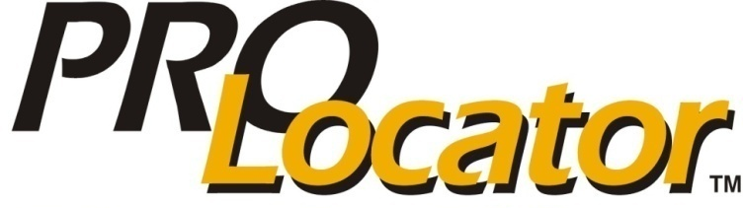
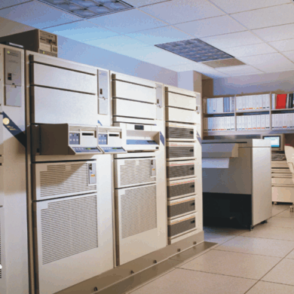


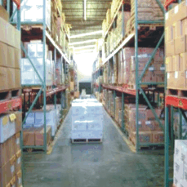

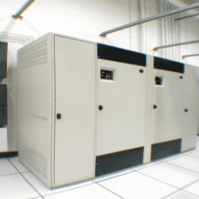

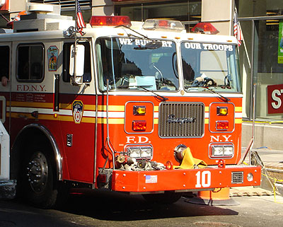
▪ Survey
▪ Isolate
▪ Identify
Can be Used Anywhere
Applications
APPLICATIONS
■ Computer Rooms
■ Power Plants
■ Office Buildings
■ Warehouses
■ Hospitals
■ Data Centers
■ Cleanrooms
■ Fire Departments

Slide 9
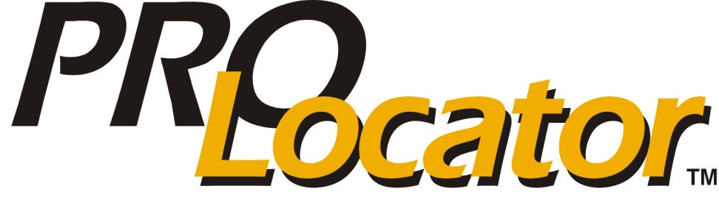
▪ Survey
▪ Isolate
▪ Identify
Portable Aspirating Fire Detection

Slide 10
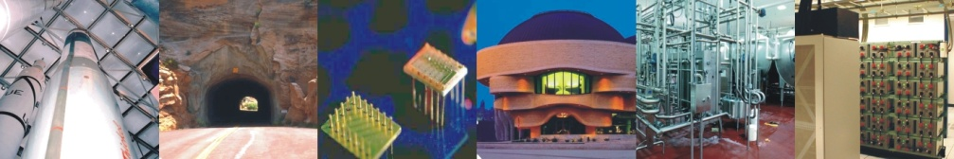

One Company, Five Great Products

