Slide 1


Notes:
Introductions

Slide 2






Very Early Warning
Fire and Smoke Detector
Early Warning
Smoke Detector
IR3 and UVIR Flame Detector
Digital Linear Heat Detector
www.safefiredetection.com
Air Sampling
Pipe and Fittings
Linear Heat Detection
Installation Supplies
Notes:
Hi my name is XXXXXXXXXXX. I am here to discuss air sampling smoke detection for Safe Fire Detection. Safe manufactures specialty detection products including air sampling smoke and fire detectionand , Safecable linear heat detection, safe flame flame detectors, Redpipe air sampling pipe and fittings finally redgear linear heat detection custom installation materials.

Slide 3
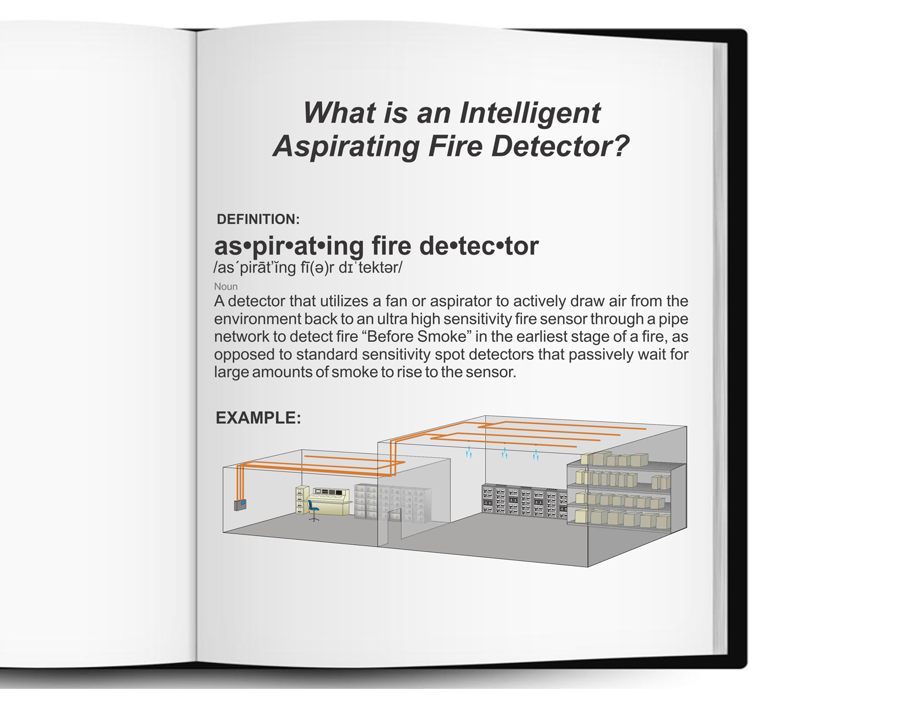
Definition
Notes:
Short version: What is air sampling? (pause) Air sampling smoke detectors use a powerful fan, located in the detector, to draw air back from the room where sample holes are located in the same place traditional smoke detectors would have been. This is called active smoke detection, along with a highly sensitive detector inside the unit to give you the earliest possible alarm. (See long version below if needed) Long version: Let’s start by taking a minute to learn what air sampling smoke detection is. Traditionally smoke detection has been done by having a fire alarm panel on the wall, then conduit would come out of the top of the panel and run throughout the room, stopping and adding a junction box every 30x30 where you would mount a smoke detector. Then you would wait for smoke to find it’s way to the smoke detector to alarm. That is called passive smoke detection. Back in the 70’s, they found it was more efficient to create an active smoke detection system, so you didn’t have to wait for smoke to hopefully find it’s way to the smoke detector. That was the beginning of air sampling smoke detection. Now you have an air sampling smoke detector mounted to the wall, which has a fan in it that draws air back to the detector, through pipe, that is ran throughout the room, similar to how the old pipe was ran. But now you have no wire inside, and where each smoke detector use to be is now a sample hole. Now you don’t have to wait for smoke to rise to the smoke detector, as the fan is pulling air from each of the smoke detector locations back to the detector enclosure. Which has an ultrasentive sensor inside to analyse the air as it comes back, alarming much faster and at an earlier level than conventional smoke detectors.

Slide 4
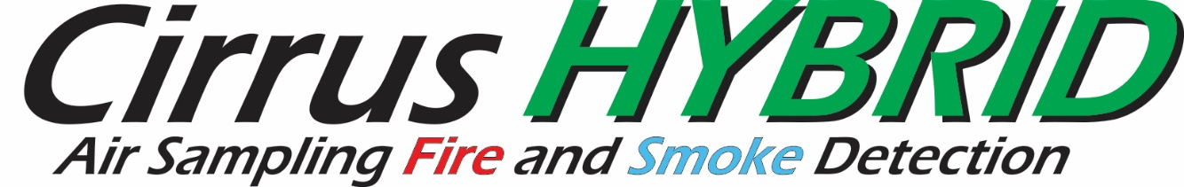
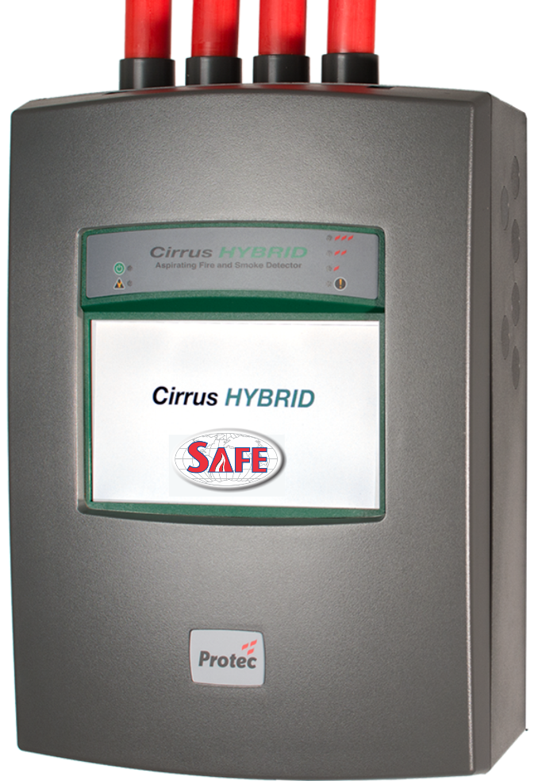



Protects Up To 90,000 sq. ft from a single detector
THE NEXT GENERATION IN EARLY WARNING
FIRE & SMOKE DETECTION
The First and ONLY Dual Technology Early Warning Detector
True Intelligent Alarm Decision Making
Notes:
In the past there has been Vesda that can detect early warning smoke. And there was CCD which can detect early warning fire. Before smoke. Now there is a new detector called Hybrid which is a dual technology detector where you can choose optical early warning smoke detection like a Vesda or early warning fire detection like a CCD which detects before some. OR BOTH!! It gives you true intelligent alarm decision making. Introducing Hybrid the first and only true dual technology early warning smoke and fire detector.

Slide 5

Notes:
Here we have a short 1 minute video to introduce you to hybrid

Slide 6
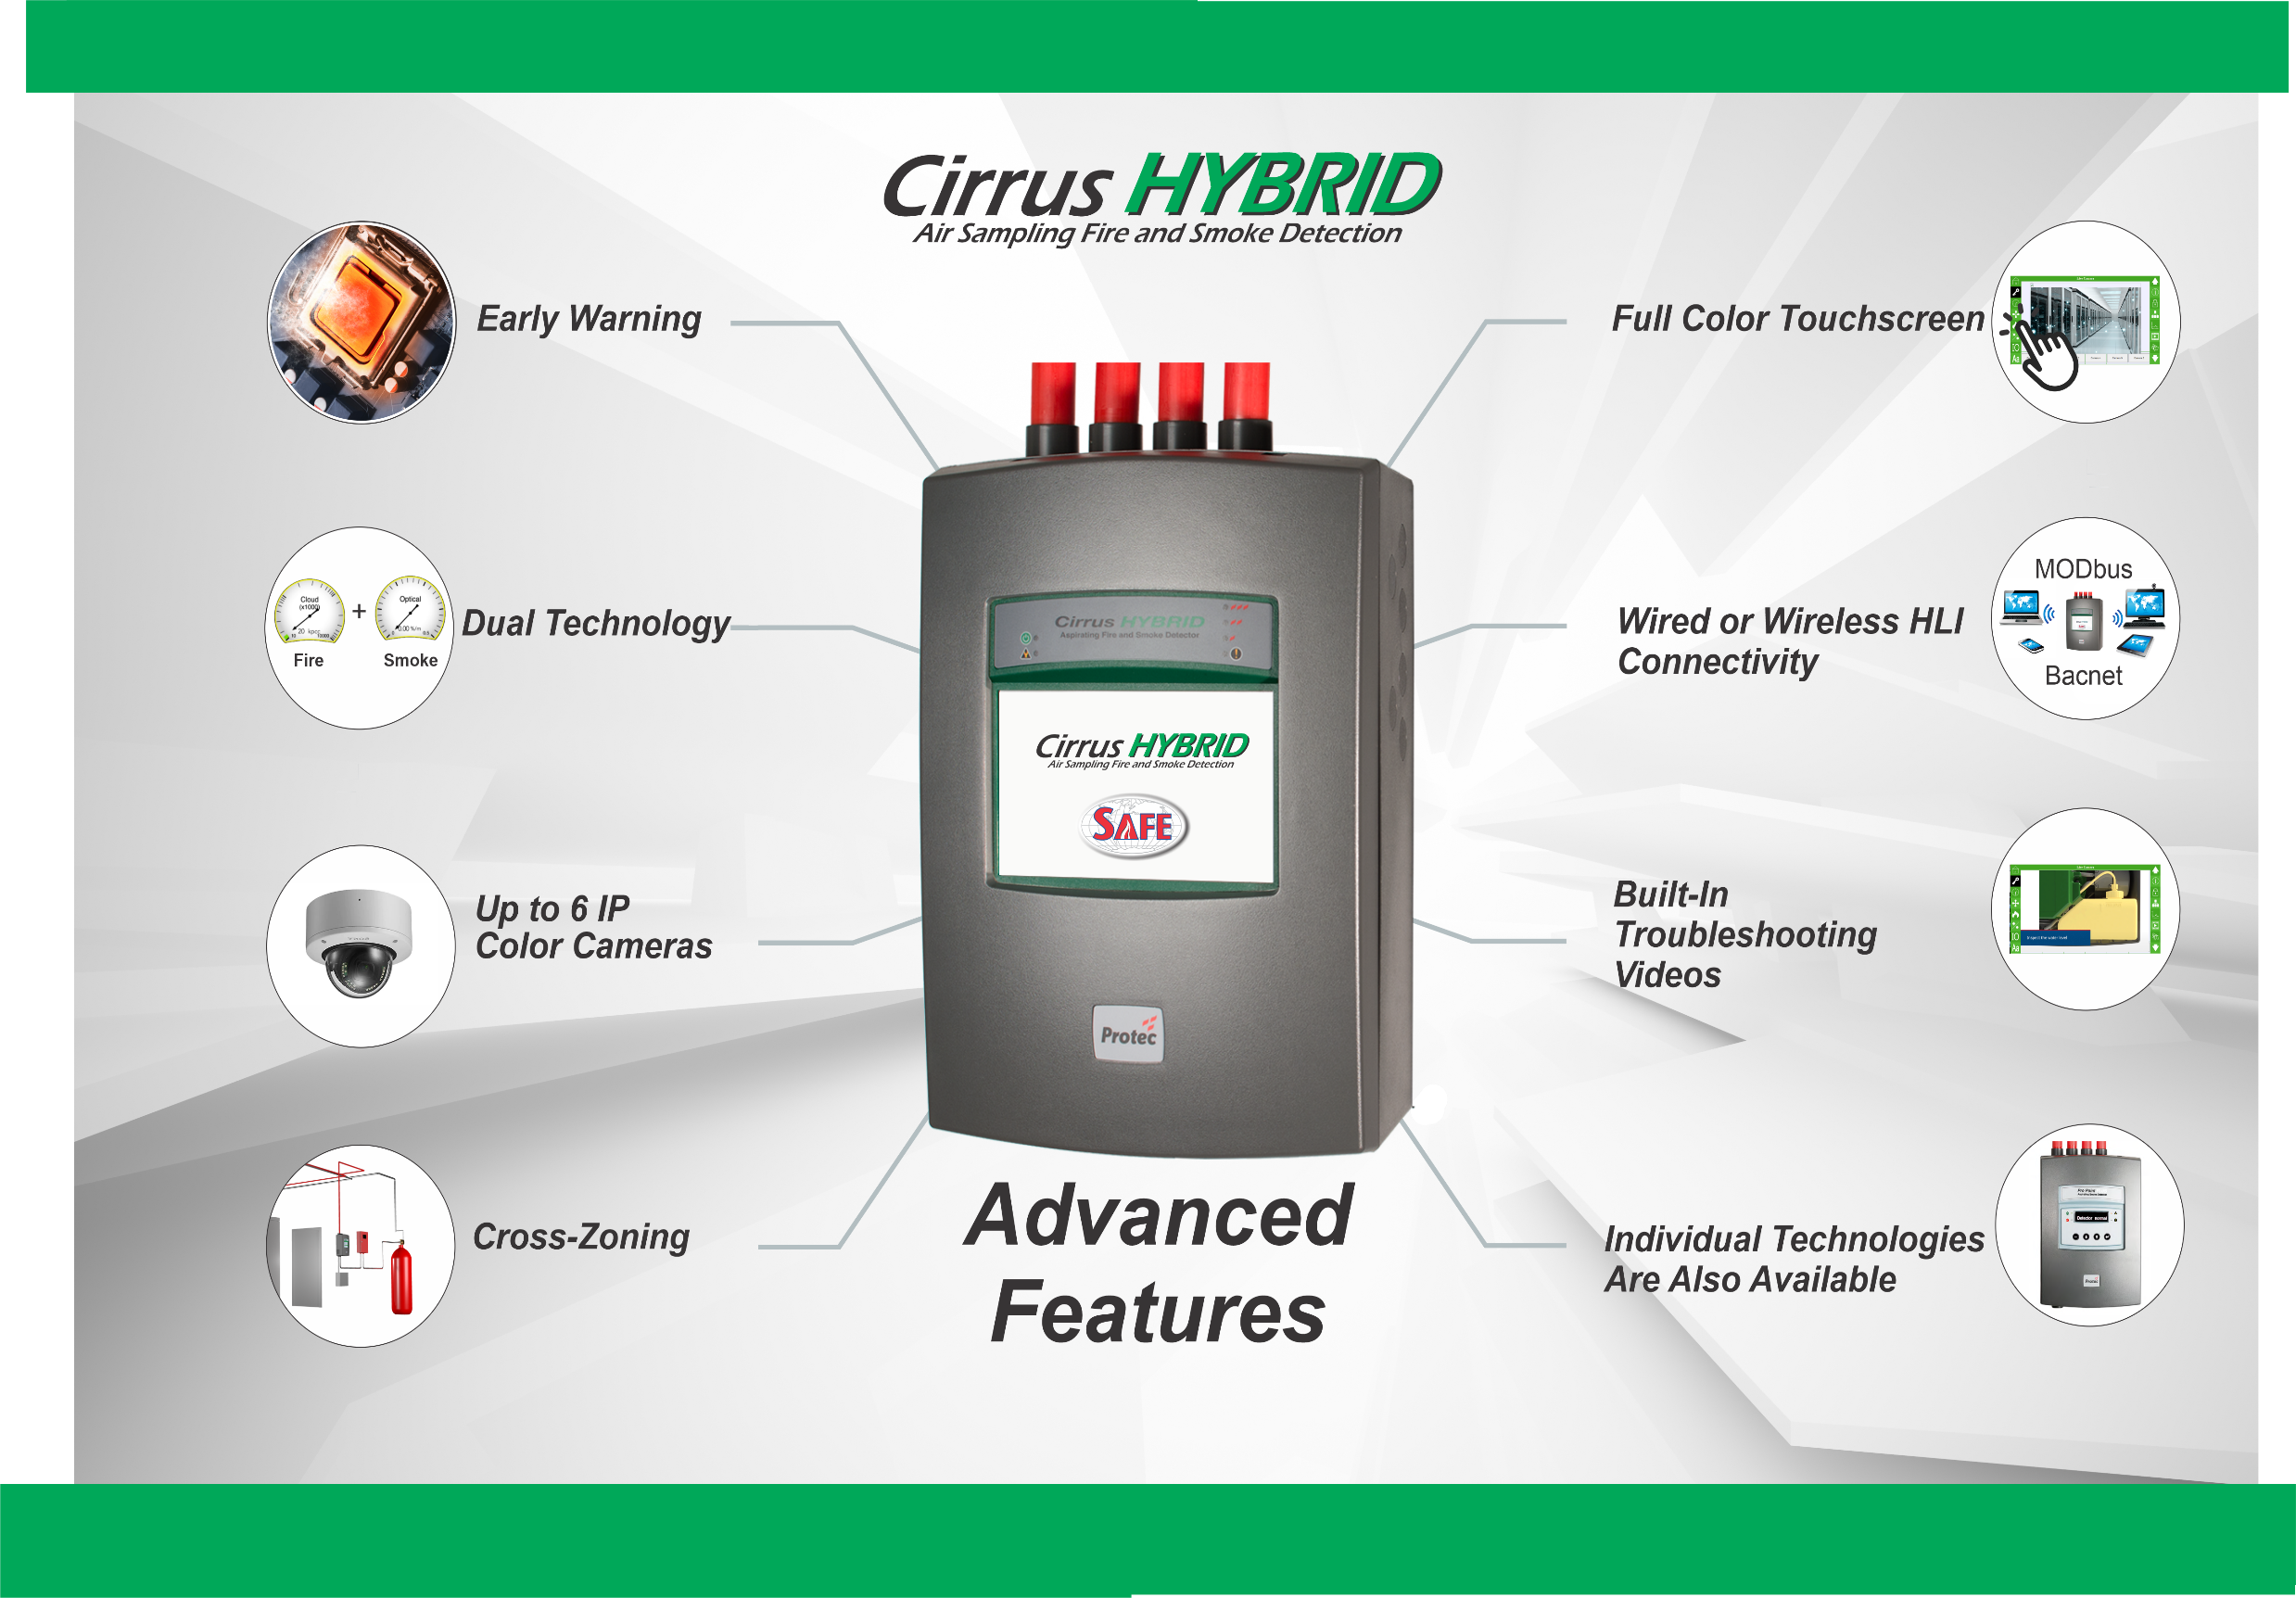
6
Notes:
What makes the hybrid stand out from all the standard features we still have are it’s 8 unique additional features that surpass all the standard features from previous air sampling detectors. These unique features offer the user unparalleled detection, protection, and ease of use.

Slide 7


Early Warning
8 Advanced Features
Early Warning Fire
Early Warning Smoke
Detect hours in advance
Prevent business interruption
Notes:
Hybrid offers the earliest detection possible for both smoke and fire giving you hours of advance warning to address the problem at it’s earliest stage before it has a chance to propagate into a situation which could cause damage or even business interruption.

Slide 8
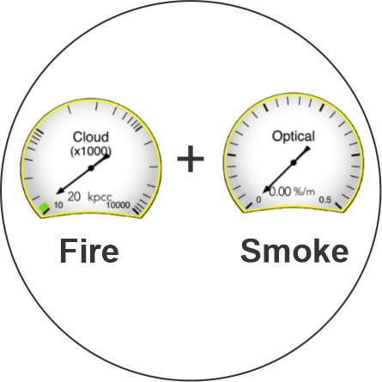
Dual Technologies
8 Advanced Features
Cloud Chamber CCD
Optical SCD
Smart Signal: CFS
Widest range of detection possible
No False Alarms
Notes:
Hybrid’s unique dual technology gives you the widest detection range ever assembled in a single detector. The Hybrid uses a Cloud chamber (CCD), which can detect overheating at the earliest stages of a fire, before smoke; and, an early warning optical sensor (SCD), like a vesda, looking for the earliest signs of smoke. The combined fire signals (what we call smart signal) gives you the widest sensitivity range ever and the ability to make true intelligent alarm decision making. Fore example, have you ever come into a room and smell something overheating but not see anything? The CCD is kind of like your nose, and can sense the fire without anything there to see. The SCD is more like your eyes, which can see the smoke once the fire grows to the point it produces smoke. Smart signal gives you the information from both technologies, as you would with your nose and eyes, to make the best intelligent decision to what’s happening in the environment around you while eliminating false alarm.

Slide 9
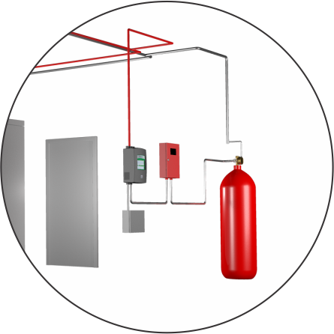
Cross Zoning
8 Advanced Features
Cross zone two technologies from one pipe
Cross zone two technologies from multiple pipes
Cross zone two detectors with cross zoned pipes
Safely discharge suppression system
Notes:
The Hybrids dual technology allows for the first time ever, to cross zone two different technologies into one signal that can be used to safely discharge a suppression system. This can be done by cross zoning the two technologies from one pipe, or from two different pipes giving you the freedom to choose the best combination to help ensure no unwanted discharges. Using two detectors, both cross zoned with two technologies, can give you the safest combination achievable.

Slide 10
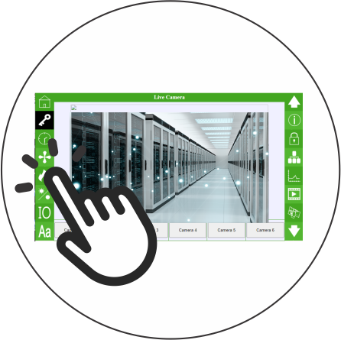
Full Color Touchscreen
8 Advanced Features
7” Touchscreen
Program and repair from screen
No additional devices required to program
Built-in troubleshooting videos
Notes:
Another first for the Hybrid is it’s 7 inch full color touchscreen. It offers you ease of programming and information display without requiring any additional devices or programmers like Vesda does. This allows you to securely go through all the functions of the detector via programable logins.

Slide 11
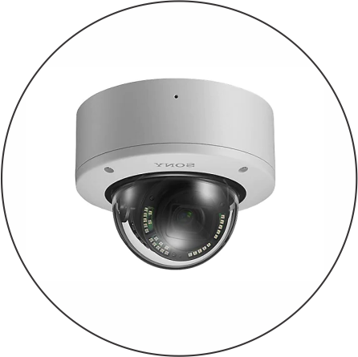
Up to 6 Color IP Cameras
8 Advanced Features
View at detector or from RDP by fire alarm panel
See inside the hazard before you enter
Network in with buildings existing cameras
Notes:
Hybrid is the only detector where you can connect up to 6 color ip cameras where you can approach the front of the detector and see what is happening within the environment before you endanger yourself by entering an unsafe area. In addition, a remote display is also available which can be located next to your fire alarm panel, to give you the ability to both respond to the fire alarm panel and see inside the hazard to know how best to respond to the alarm. These cameras can also be networked into any existing building camera network.

Slide 12
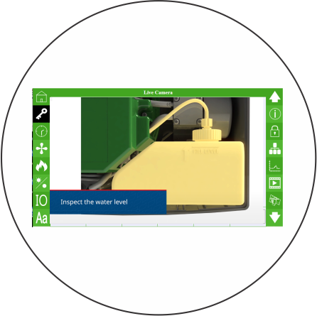
Built-in Troubleshooting Videos
8 Advanced Features
How to repair videos built in
Step by step repair instructions
Follow along as the repair technician teaches your technician right onsite
Notes:
In addition to seeing the live pictures from the IP cameras, you can also view built in troubleshooting videos via the touch screen. If the detector has a fault the technician can view the corresponding built in troubleshooting video to offer guidance on how to correct the problem.

Slide 13
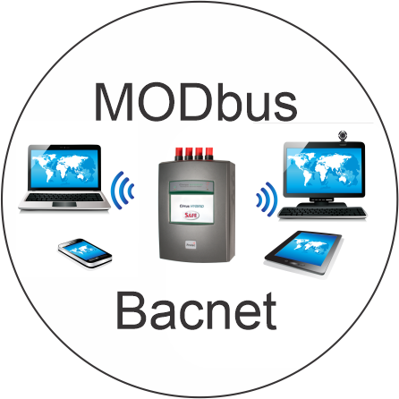
Wired or Wireless HLI
8 Advanced Features
Supports full range of networking capabilities
Wired and Wireless HLI
Wired IP
Modbus and BACnet
Hercules networking software
Notes:
The Hybrid has many ways you can communicate with it. In addition to programmable dry contacts, the Hybrid has onboard wired IP and RS485 interfeces or you can add an HLI module to communicate via modbus and BACnet. These features can viewed via our new networking software, Hercules. The HLI can also be customized to interface directly with your fire alarm panel.

Slide 14
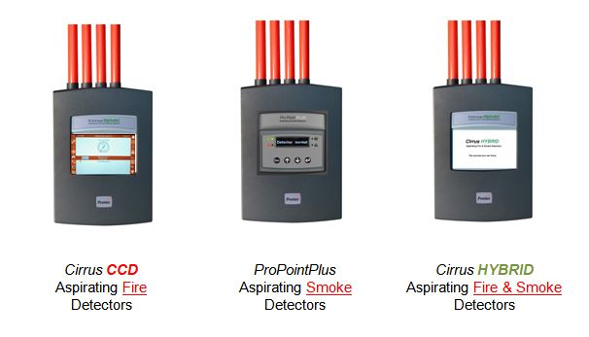
Individual Technologies
8 Advanced Features
Dual Technologies available individually
CCD Detector: Cloud Chamber (fire detector)
ProPointPlus Detector: Optical (smoke detector)
Notes:
Finally, the Hybrid is the first dual technology detector offering you both early warning fire and early warning smoke detection in a single detector. But both of the technologies are also available individually depending on your environmental needs and budget. The ProPointPlus, is the optical based detector like a Vesda for early warning smoke, or the CCD detector, which is the cloud chamber based detector for the earliest signs of fire.

Slide 15

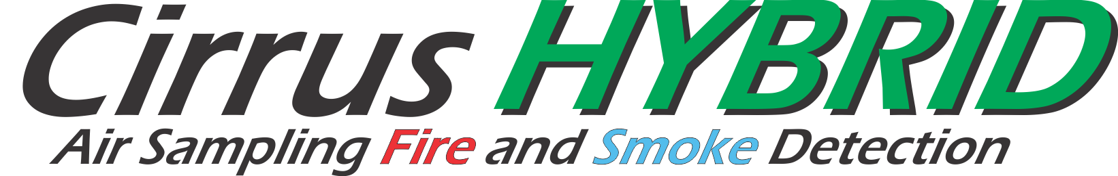


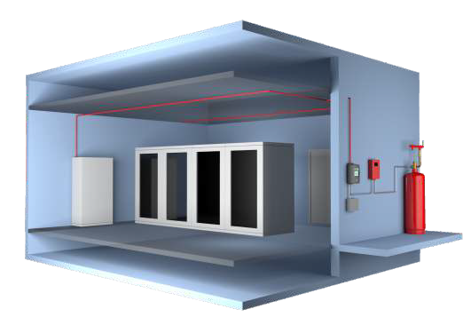


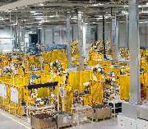
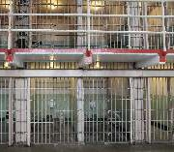
Applications
Energy
With 40 years of experience in Power Facilities, the Hybrid new tool in solving both the standard and specialized detection needs of all types of power facilities. The additional features of the Hybrid give us the new tools to offer custom solutions for even the most difficult of environments.
TeleComm/Data
With the multiple detection capabilities of the Cirrus Hybrid, it is now possible to Cross Zone and provide not only the highest level of detection, but the ability to safely release your suppression system.
Above Ceilings/Plenums and Ducts
InRooms and In-Cabinet
(Optional)
Cross-Zoned
Commercial/Retail
Hybrid consists of two technologies giving you the earliest detection of both technologies. But it can also be offered to you as each technology individually satisfying the needs of any commercial or retail facility.
Suppression
Freezer/Warehouse
The Hybrid can be configured for special applications like freezers and warehousing in our CCD and ProPoint models that are specifically tailored for cold and high ceiling environments like freezers and warehouses.
System
Subfloors
Industrial
Industrial facilities offer unique challenges that the Hybrid can solve with its multi-technology design. It has the ability to detect both pre- smoke and smoke and giving you the ability to make decisions based on either technology.
Anywhere....
The Engineers at Safe Fire Detection have experience designing systems for almost any application. If you don’t see your application listed here, call us and we will be happy to show you how we can help protect your facility.
704-821-7920
Institutions
The Hybrid can also be configured to solve the needs of the multitude of different institutional facility requirements of institutional applications. Only the Hybrid has all the detection abilities and features necessary for these environments.
Notes:
No matter what your application or individual detection needs are, the Hybrid, ProPoint, or CCD detectors can solve most any project requirement you have.

Slide 16
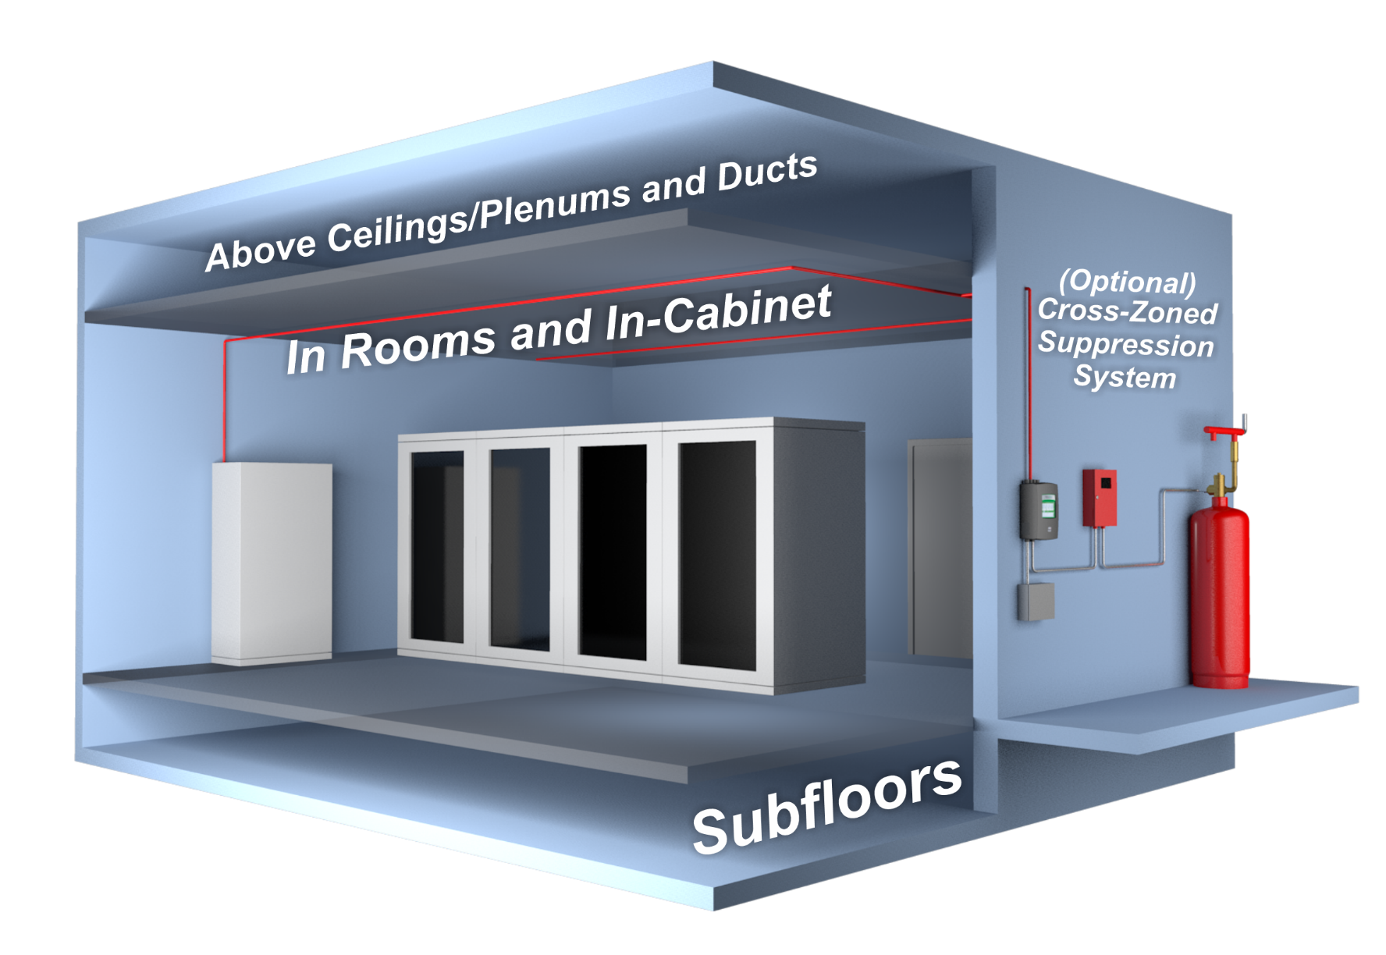
Installations
Notes:
We have talked about what Hybrid is and where you use it, lets talk about how to install it.

Slide 17
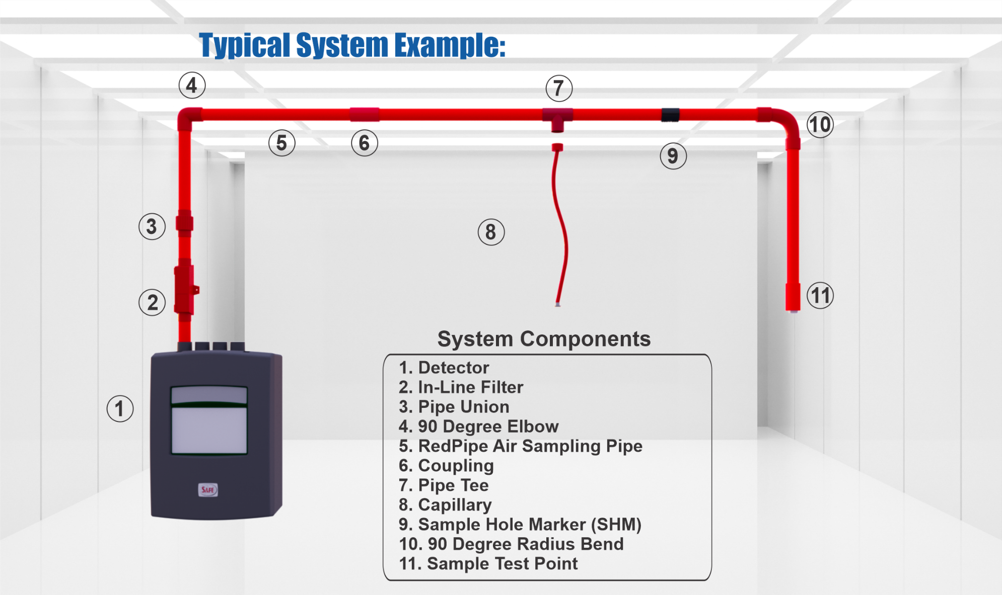
Items Needed for a Typical System Install
Notes:
Before we talk about installing a system, we need to understand the different parts of a early warning air sampling system. Here you will see the individual basic parts are labeled (review all parts with the audience). Of course systems can get much more complicated, but these are the basic parts of every system.

Slide 18

Notes:
Safe is the only company that manufactures our own installation materials. The installation materials for the Hybrid product line come under our product name RedPipe. Redpipe is the only UL listed pipe and fittings approved specifically for use with air sample smoke detection systems. Blazermaster is UL listed as a sprinkler pipe, not an air sampling pipe.

Slide 19

Notes:
Here we have a short one minute video on Red.pip.
Here we have a short 0one minute video on redpipe

Slide 20
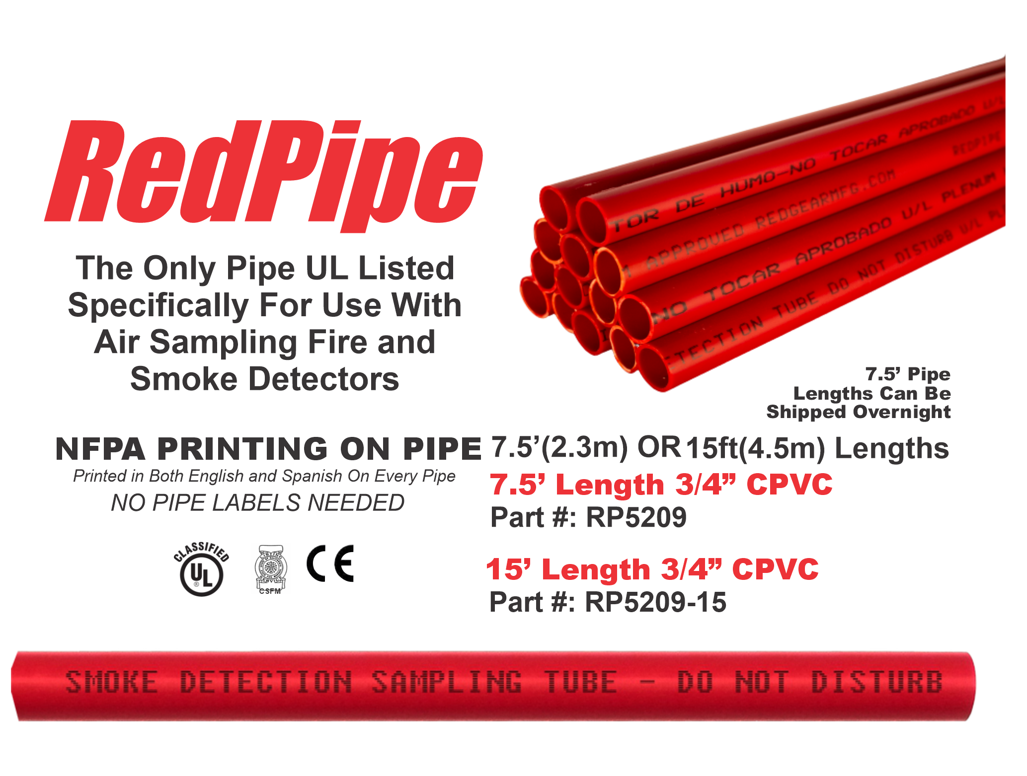
Notes:
Besides Redpipe being the only UL approved pipe and fittings specifically listed and approved for use with any air sampling detector, Redpipe is approved for plenum spaces and is preprinted with NFPA required text in both English and Spanish so pipe labels are no longer needed. RedPipe comes in both 7.5 and 15ft lengths allowing for freight or overnight shipments of the 7.5 foot lengths.

Slide 21
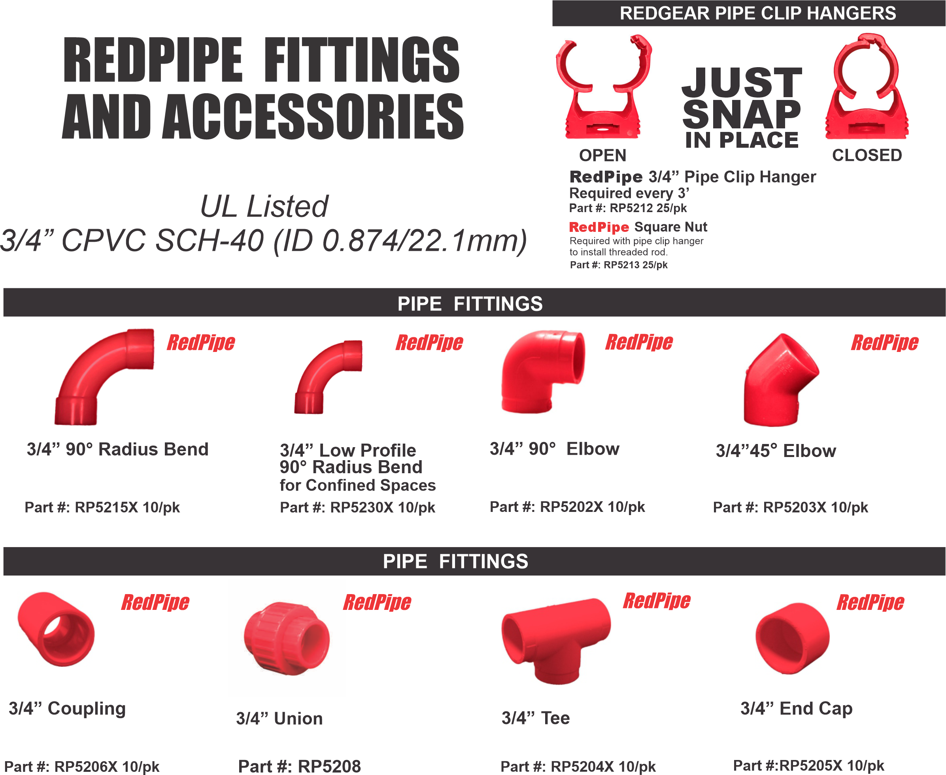
Notes:
A complete line of RedPipe fittings and accessories are available in our RedPipe catalog available online or by request.

Slide 22

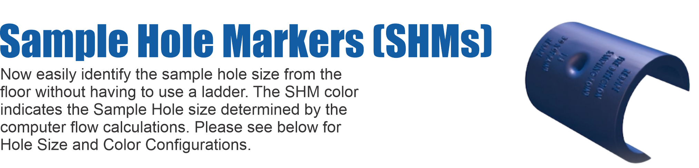
Air Sampling Pipe and Fittings
Notes:
One of the steps forward in air sampling pipe networks design is sample hole markers, or what we call SHM’s. It has become a concern of AHJ’s that systems are designed and installed correctly so SHM’S were developed so you can see the calculated hole size is correct from the floor. A 3/8” hole is drilled into the pipe and then the appropriate SHM is clipped onto the pipe.

Slide 23


SIMPLY DIVIDE YOUR TOTAL SQ.FT. BY 2,500
EQUALS THE NUMBER OF KITS YOU NEED
Notes:
The newest addition to our RedPipe catalog is the RedPipe Kit. RedPipe Kit makes determining how much pipe you need for your system fast and easy. Simply divide your total square footage by 2500 and that is how many RedPipe Kits you need for your project. No more pipe take offs, no more errors, no more forgetting a couple fittings at the shop. Everything you need in a single easy to carry box priced at a discounted rate from buying all the items individually. PipeKit is also overnight-able for any last minute needs. And, Oh you get one free PipeKit with every Hybrid detector you buy.

Slide 24
Summary
8 Advanced Features
Early warning
Dual Technology
Up to 6 IP Color cameras
Cross Zoning
Wired or Wireless HLI connectivity
Troubleshooting Videos
Full color touchscreen
We answer the phone
Notes:
In summary Hybrid is the most exciting new air sampling detector to hit the market since Vesda. Hybrid offers you early warning, dual technology, up to 6 cameras, cross zoning, touch screen, multiple ways to interface with the detector, built in troubleshooting videos

Slide 25
Summary
8 Advanced Features
Free Basic Design
Free Calculation
Free Technical Training
Free Pipe Kit
We answer the phone
Notes:
AND we also offer free basic design and calculations, free training, and a free Pipekit with every Hybrid order. Heck I will even offer you a free Pipekit with every ProPoint and CCD you order. Finally I wanted to talk about our outstanding level of customer service. WE ANSWER THE PHONE. Our customer service and technical staff are here to answer your questions just give us a call.

Slide 26

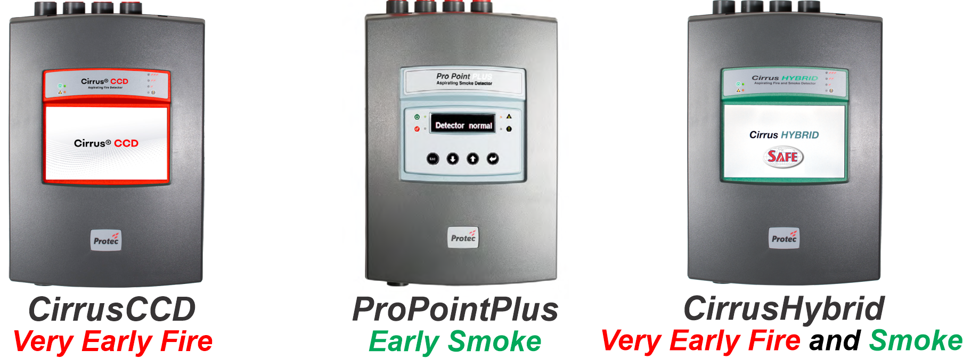
Family of Products
Notes:
Finally, the Hybrid is the first dual technology detector offering you both early warning fire and early warning smoke detection in a single detector. But both of the technologies are also available individually depending on your environmental needs and budget. The ProPointPlus, is the optical based detector like a Vesda for early warning smoke, or the CCD detector, which is the cloud chamber based detector for the earliest signs of fire.

Slide 27


Very Early Warning
Fire and Smoke Detector
Early Warning
Smoke Detector
IR3 and UVIR Flame Detector
Digital Linear Heat Detector
www.safefiredetection.com
Air Sampling
Pipe and Fittings
Linear Heat Detection
Installation Supplies
Notes:
Thank you for your time. If you have any questions I can take them now or feel free to stop up and say Hello, or call me at your earliest convenience.

