Slide 1

Notes:
INTRO: Hi, My name is “X” I am here to introduce you to Safe’s New Redpipe Kit. A complete pipe kit that has everything you need for a 2500 sq. ft. area. Simply divide your total sq. ft by 2500 and that is how many kits you need. No more pipe take-offs, no more estimating mistakes or fittings left behind when you head out to the project. Everything comes in a single box for less cost than buying them separately.

Slide 2
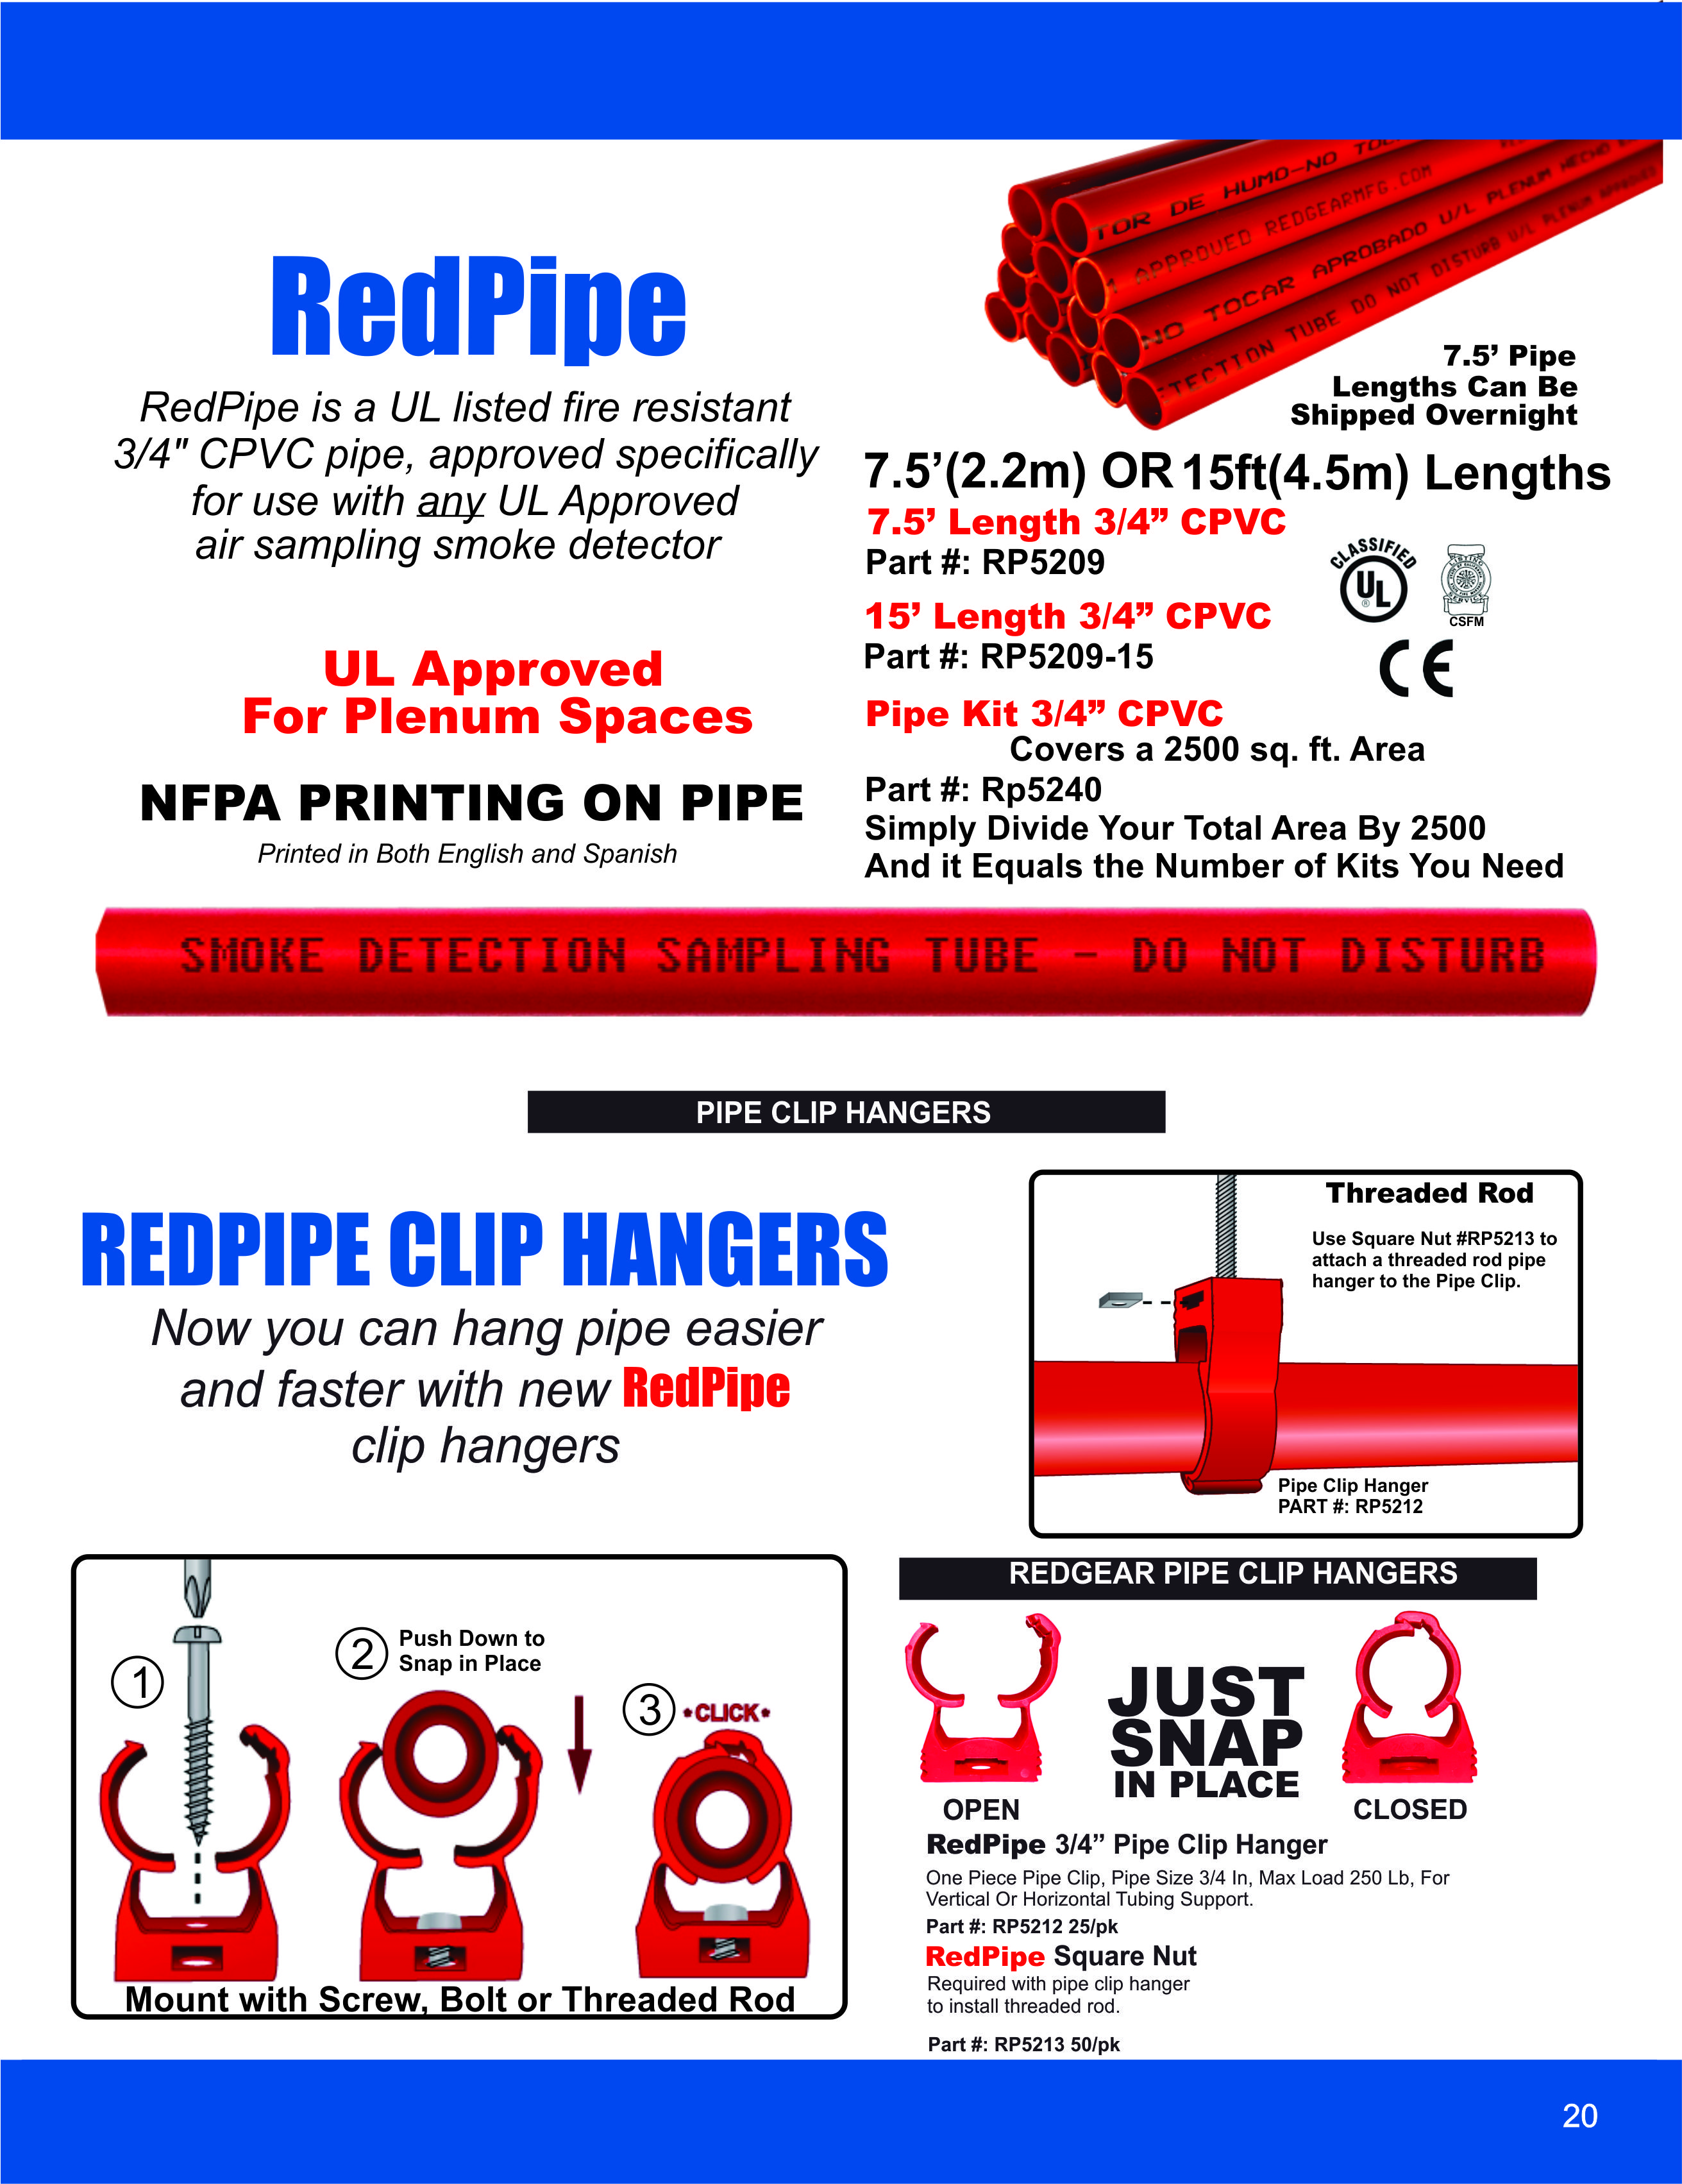
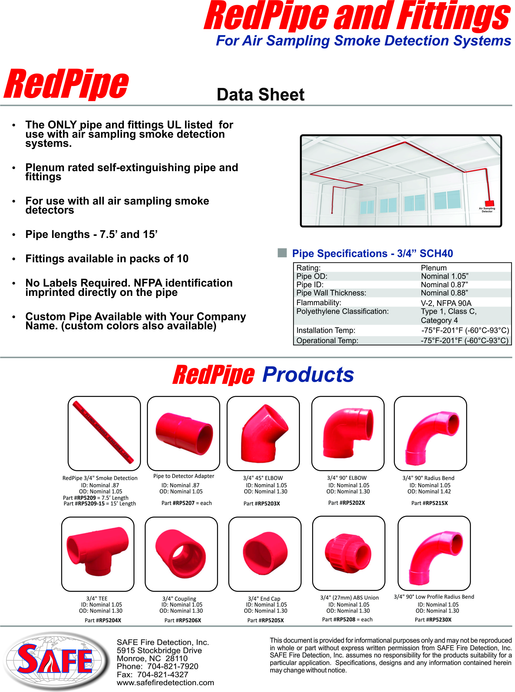
Notes:
Redpipe is the ONLY air sampling smoke detection pipe UL approved specifically listed for use with ALL air sampling smoke detectors. No labels are needed as the pipe comes with NFPA printing already on the pipe in English and Spanish. It comes in both 7 ½ and 15 foot lengths. The 7 ½ foot lengths can be shipped overnight. In addition it has snap in pipe hangers for faster, less costly installations.

Slide 3
Notes:
In addition to Redpipe being the ONLY pipe and fittings UL listed for use with air sampling smoke detection systems, they are also plenum rated and self-extinguishing. Being the only pipe that is UL listed it meets the needs of Government projects.
Here you will find the specifications for Redpipe for your submitals.
Fittings available in packs of 10 or as a package in the Pipe Kit.
Custom Pipe Available with Your Company Name. (custom colors also available) and ALL at a lower cost than the other brands

Slide 4
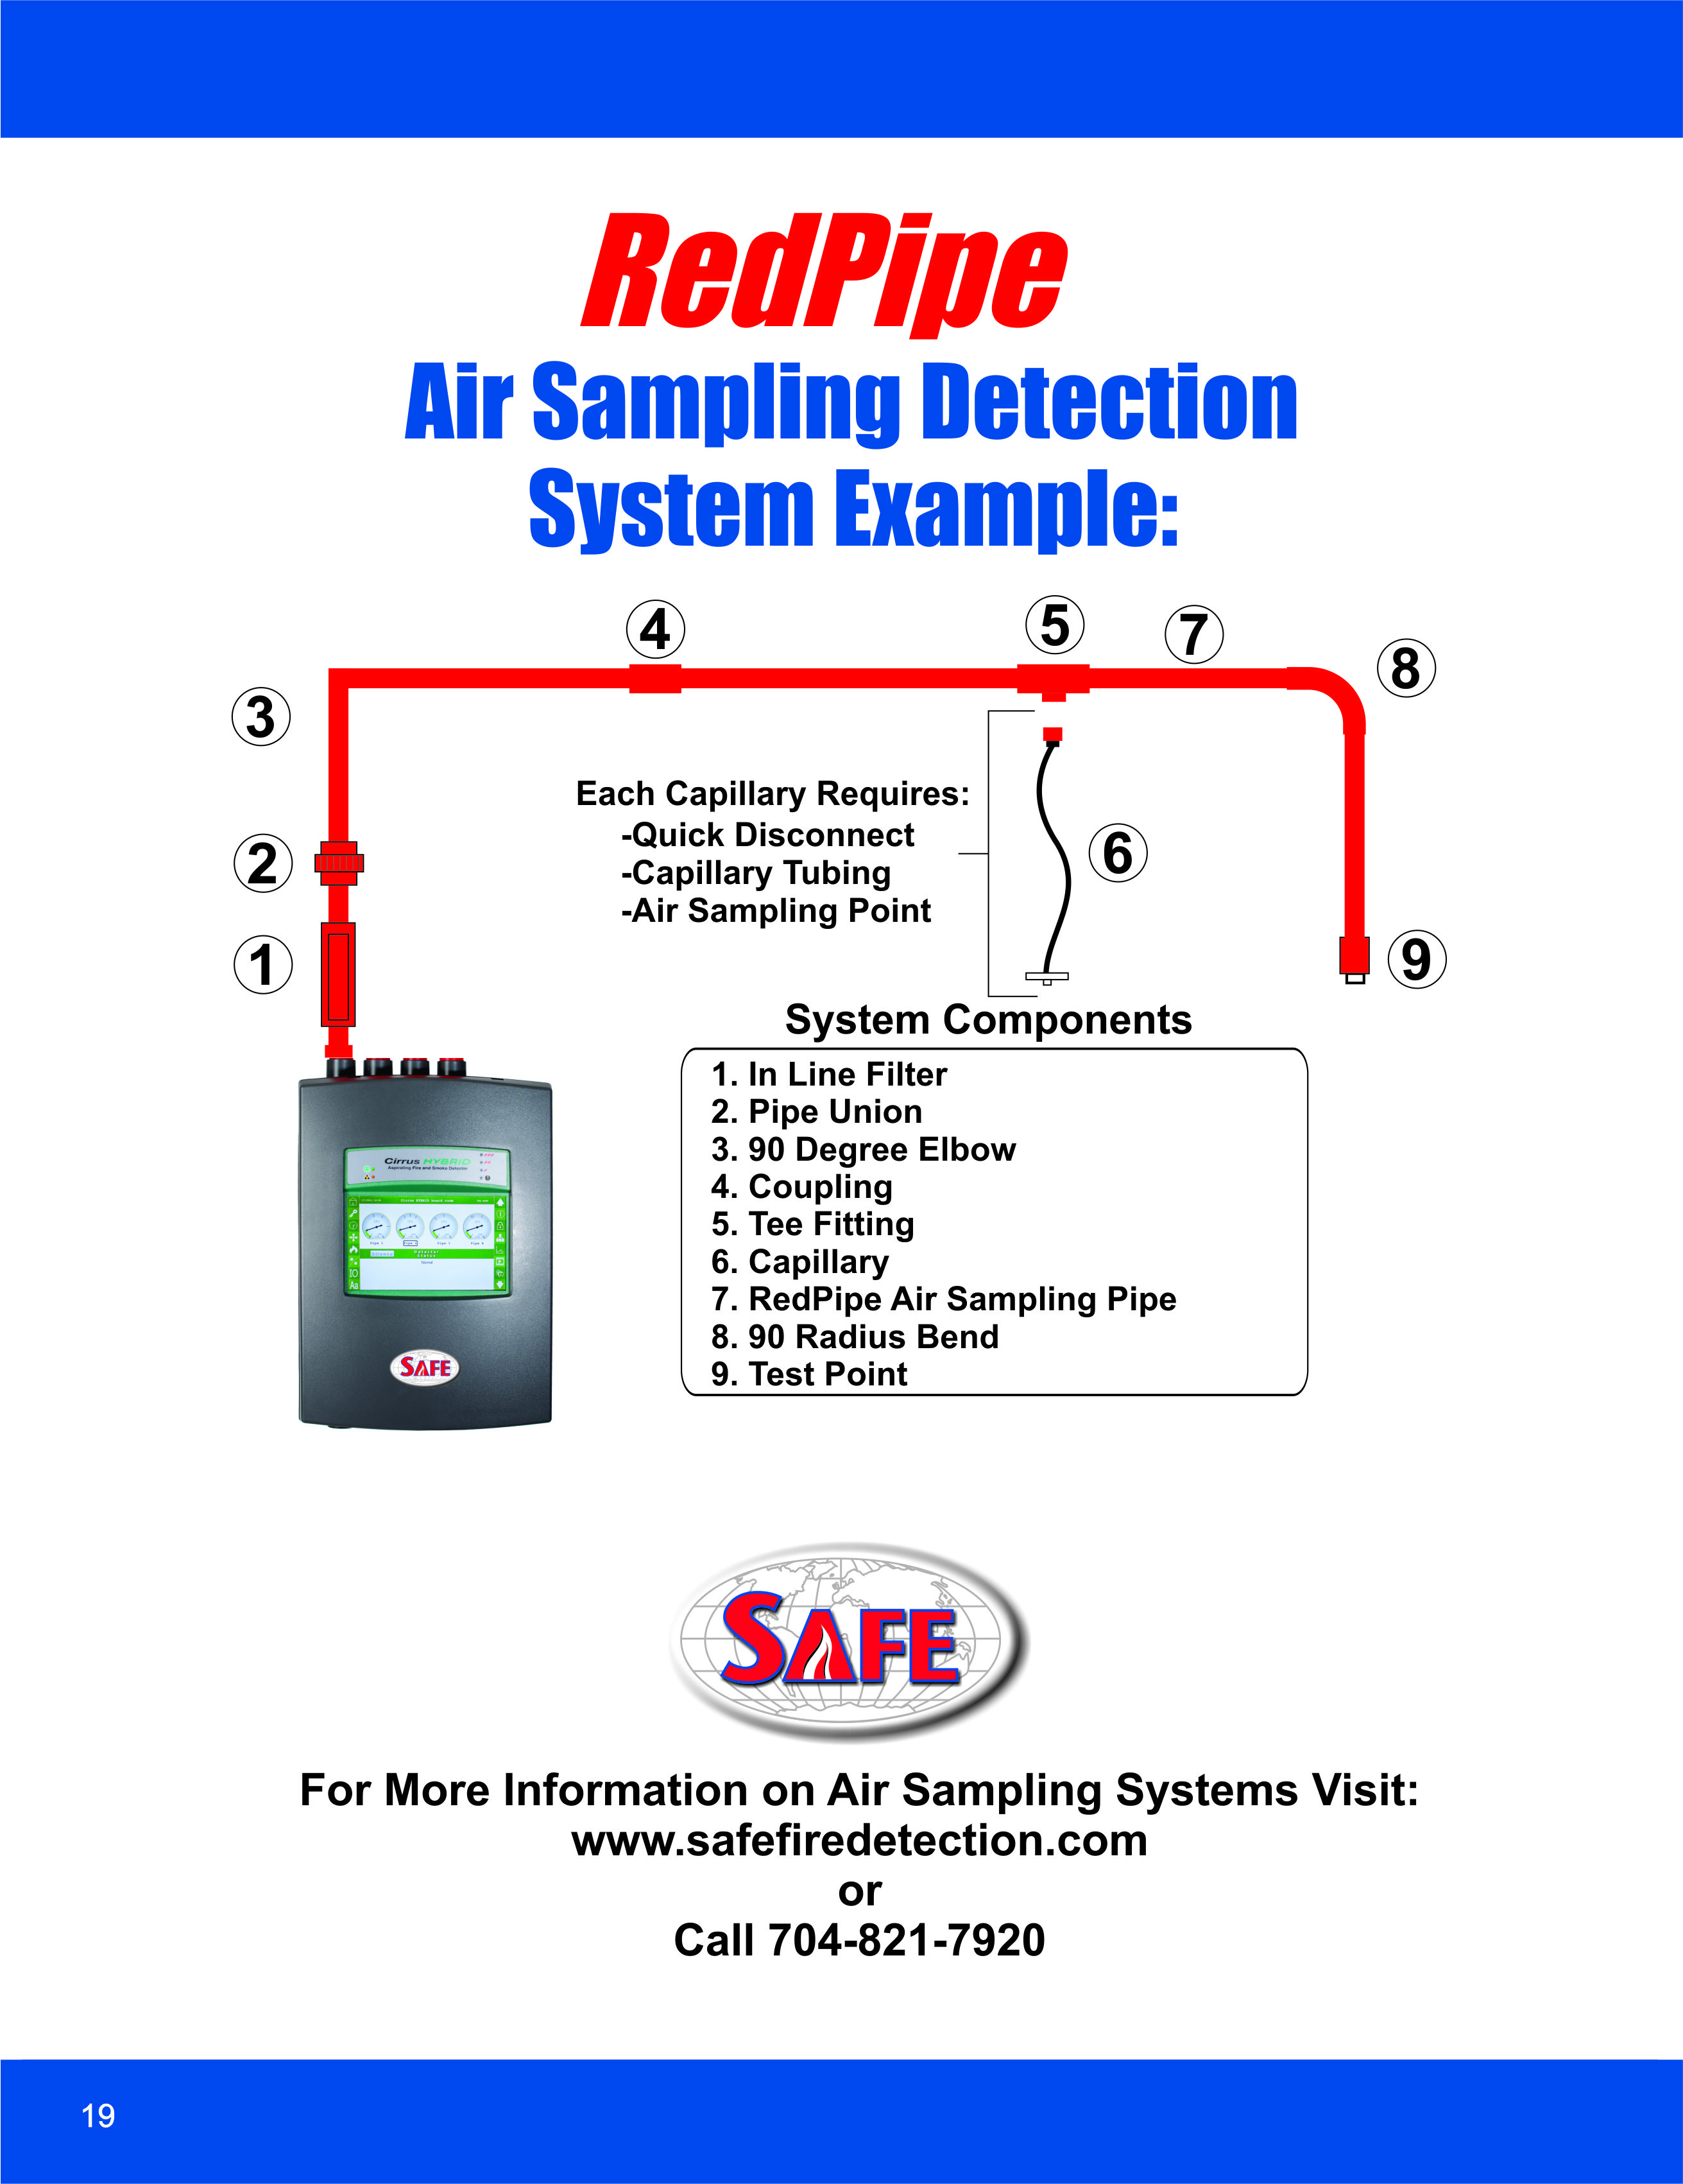
Notes:
This is a typical air sampling smoke detection system. It consists of a detector of which ANY brand like Vesda is UL approved for use with RedPipe. Then there is an optional In-Line filter for dusty environments. Then a union to allow access to the system for service and repair in the future. Number 3 is a standard 90 degree elbow. Number 4 is a standard coupling. Number 5 is a standard Tee. It can be used in the system for “U” type air sampling designs or use with Number 6 which is a capillary (Note All the individual components can be found in our Redpipe catalog). Number 7 is our Redpipe that is our 3/4” special CPVC that I spoke of on the previous slide. Number 8 is our radius bend elbow which doesn’t restrict flow if you have an unusual system with many elbows. Number 9 is our standard test point for commissioning, service and maintenance.

Slide 5
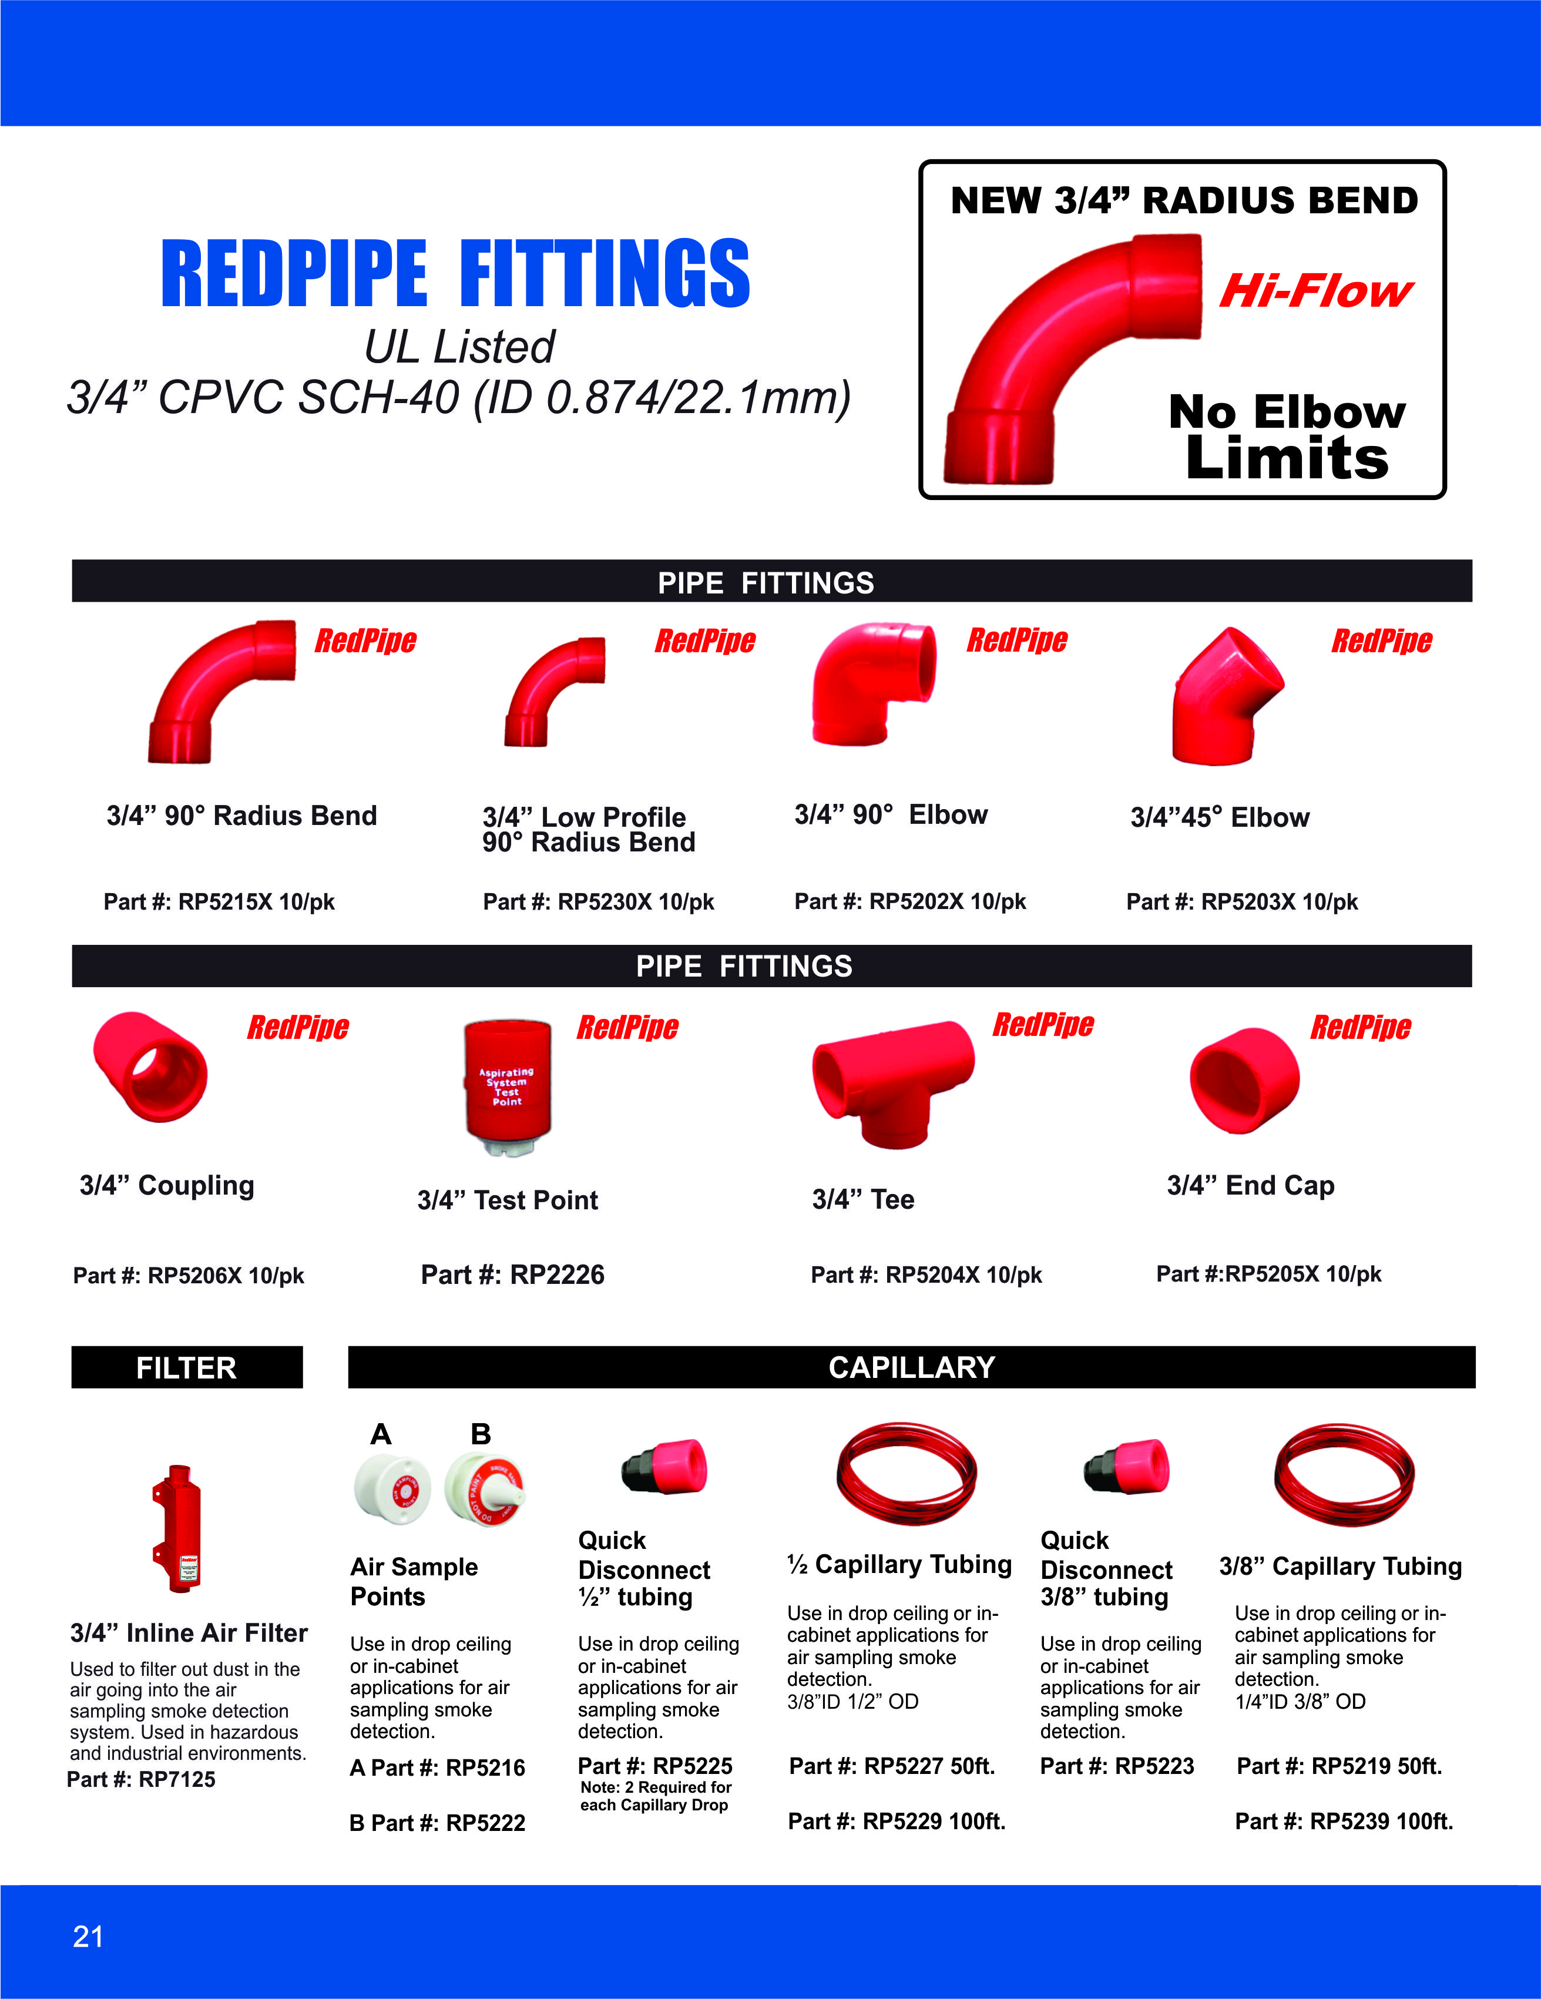
Notes:
We carry a complete line of fittings and accessories for your pipe network and all at a lower cost than the other brands.

Slide 6
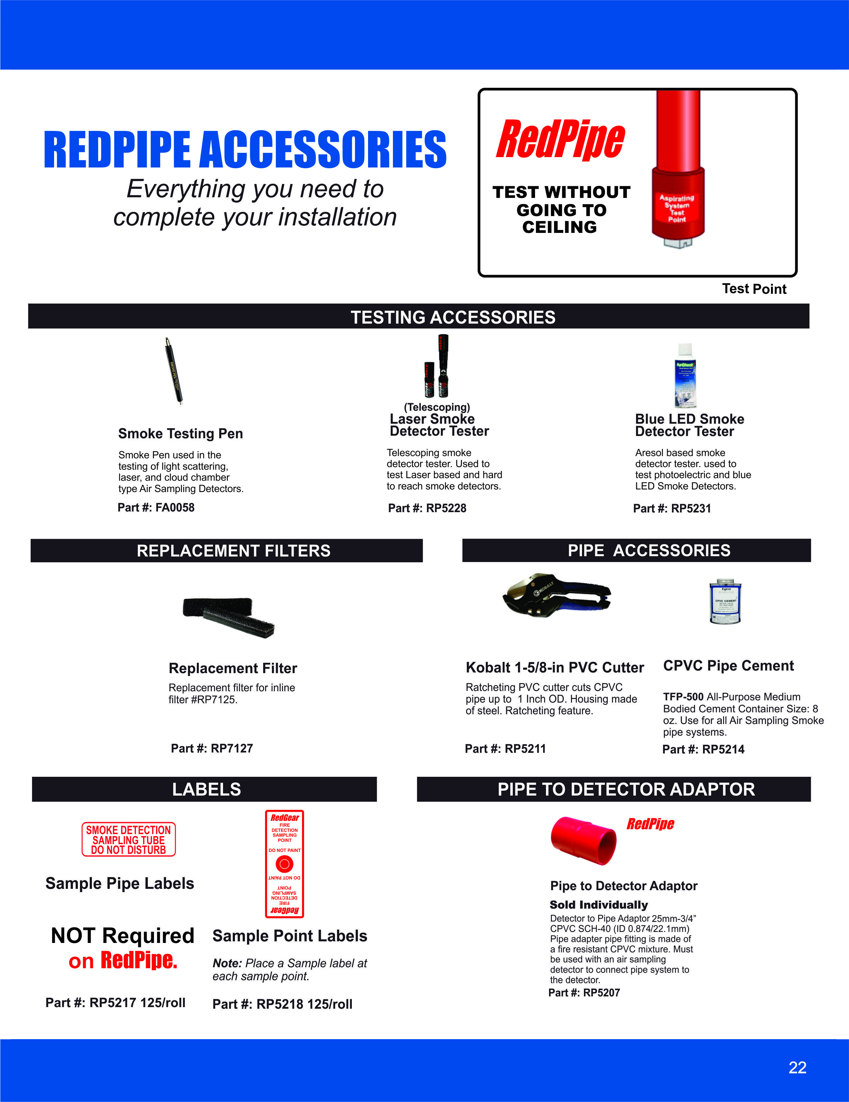
Notes:
Here we have additional accessories for testing and installations of any brand detector

Slide 7
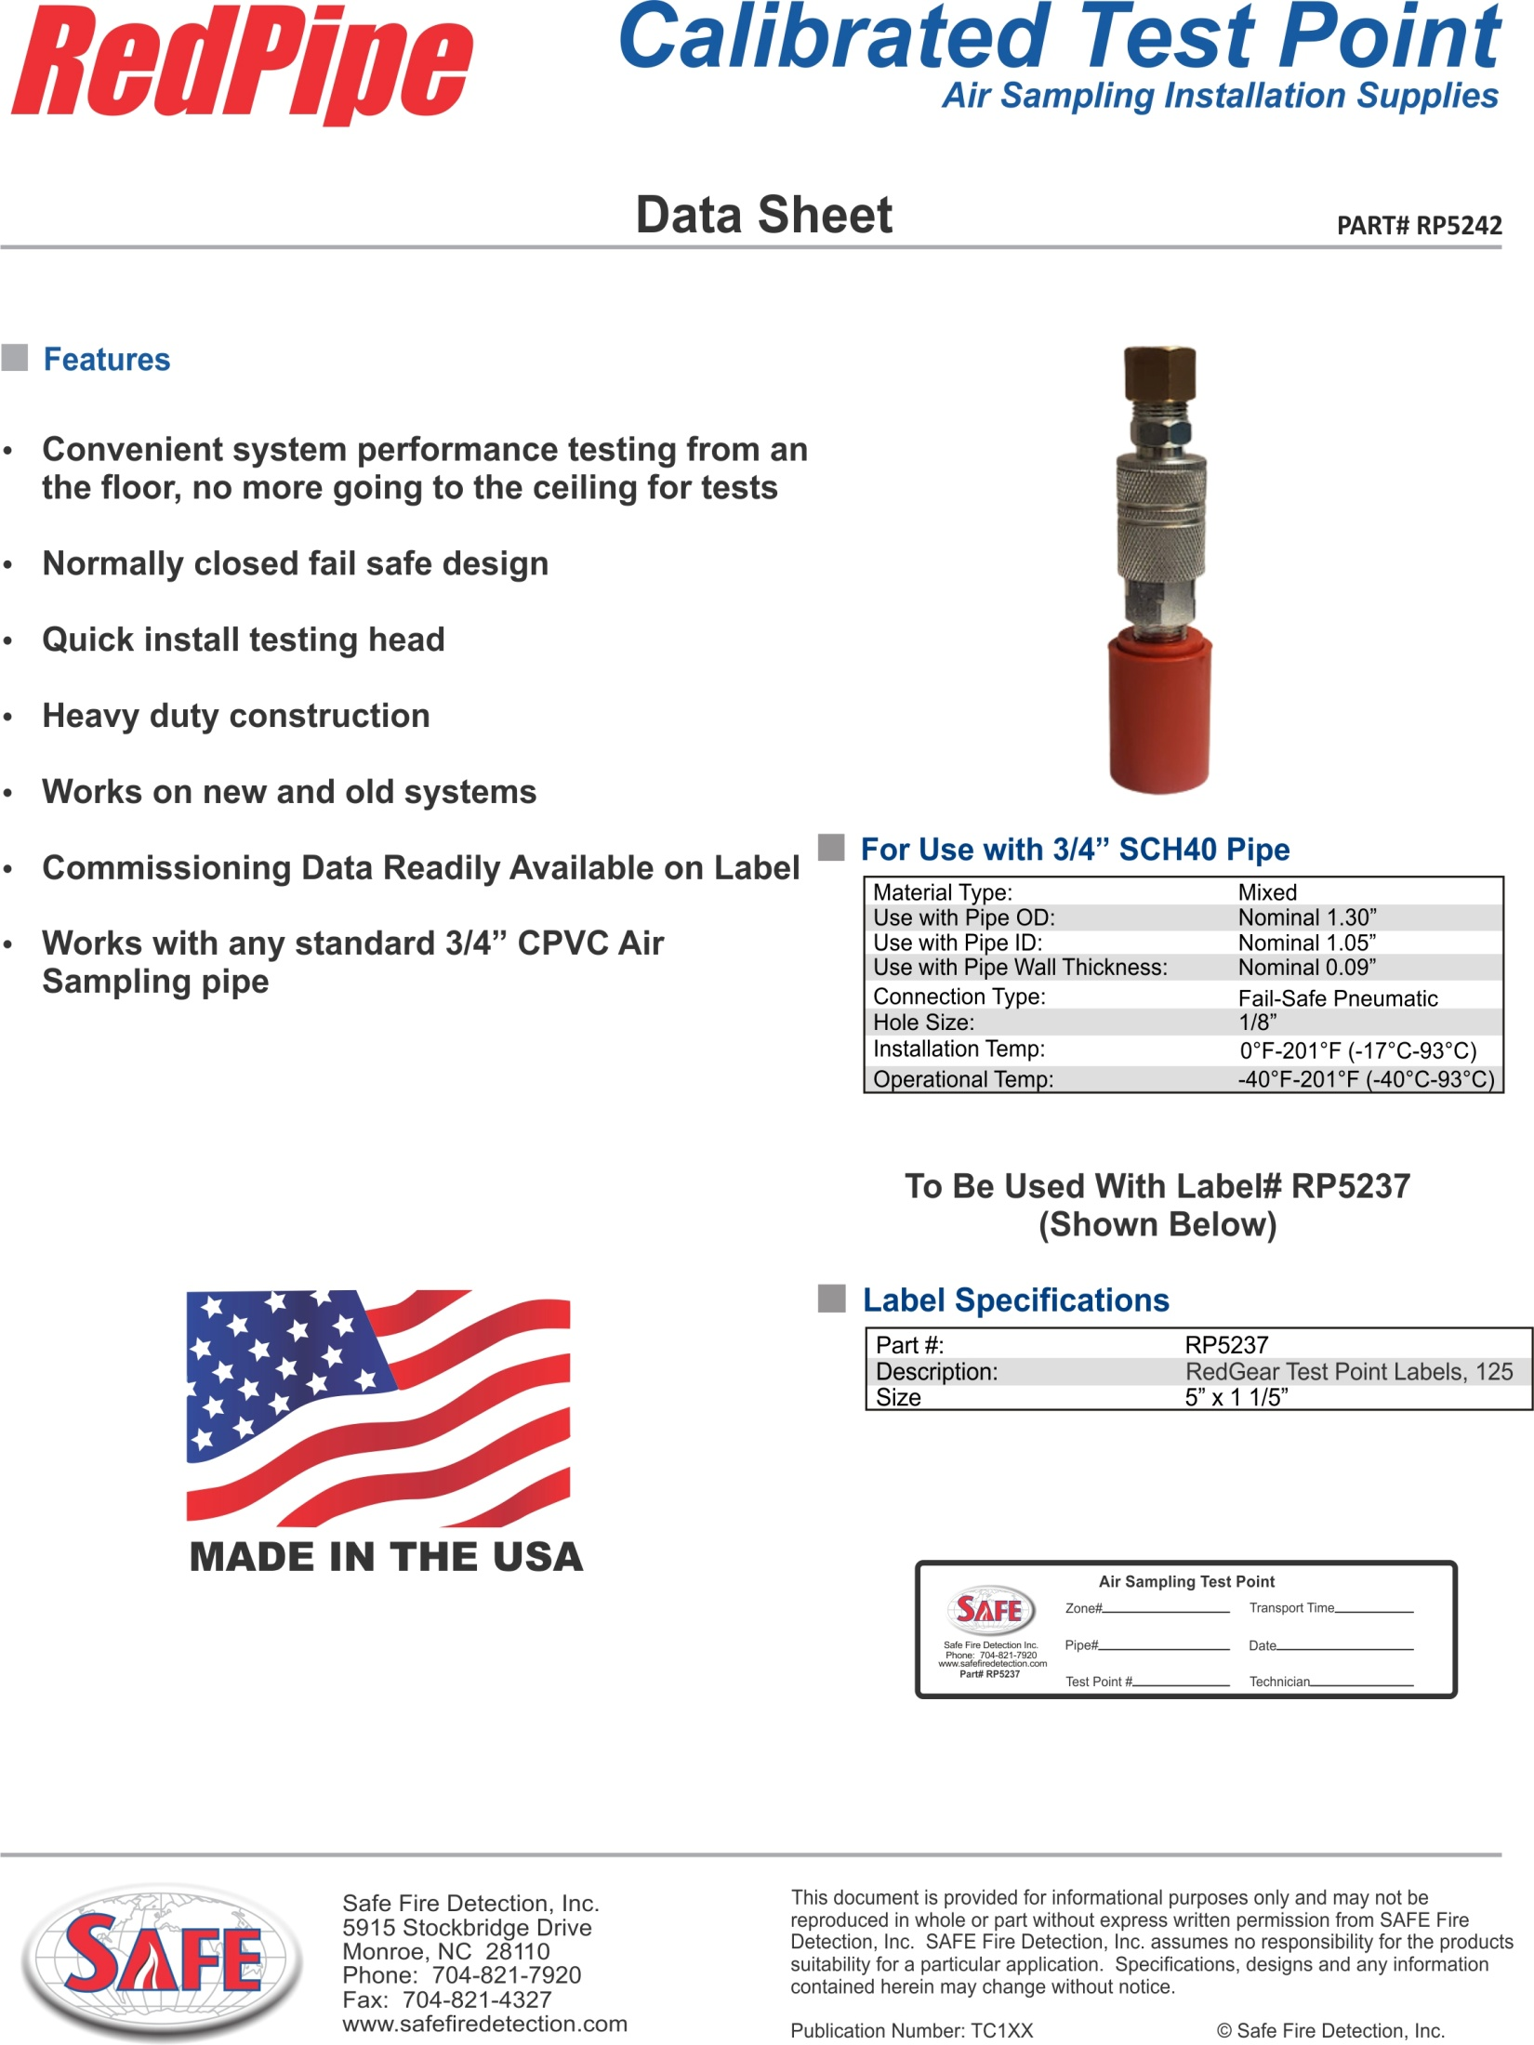
NEW
Notes:
And we have just added our new Calibrated Test Point. The new test point prevents the test point from accidentally being left open and also provides additional security by keeping unauthorized companies from servicing the system.

Slide 8
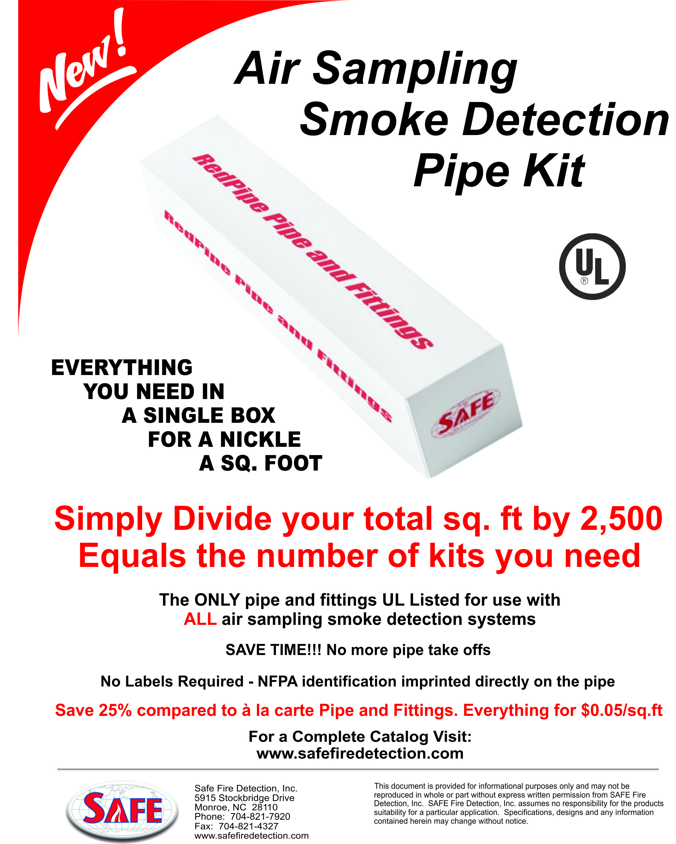
Notes:
And this is our new Redpipe Kit. It’s simplest way ever to purchase your air sampling pipe !!! Everything you need in a single box!! Just divide your total square feet by 2500 and that tells you how many kits you need. No more pipe take offs. No more estimating mistakes. No more forgotten fittings when you get to the site. Easy project staging. A single box for every 2500 sq ft. Oh I would add an additional kit if you have high ceilings. And all of this at a lower cost than buying the individual pipe and fittings.

Slide 9
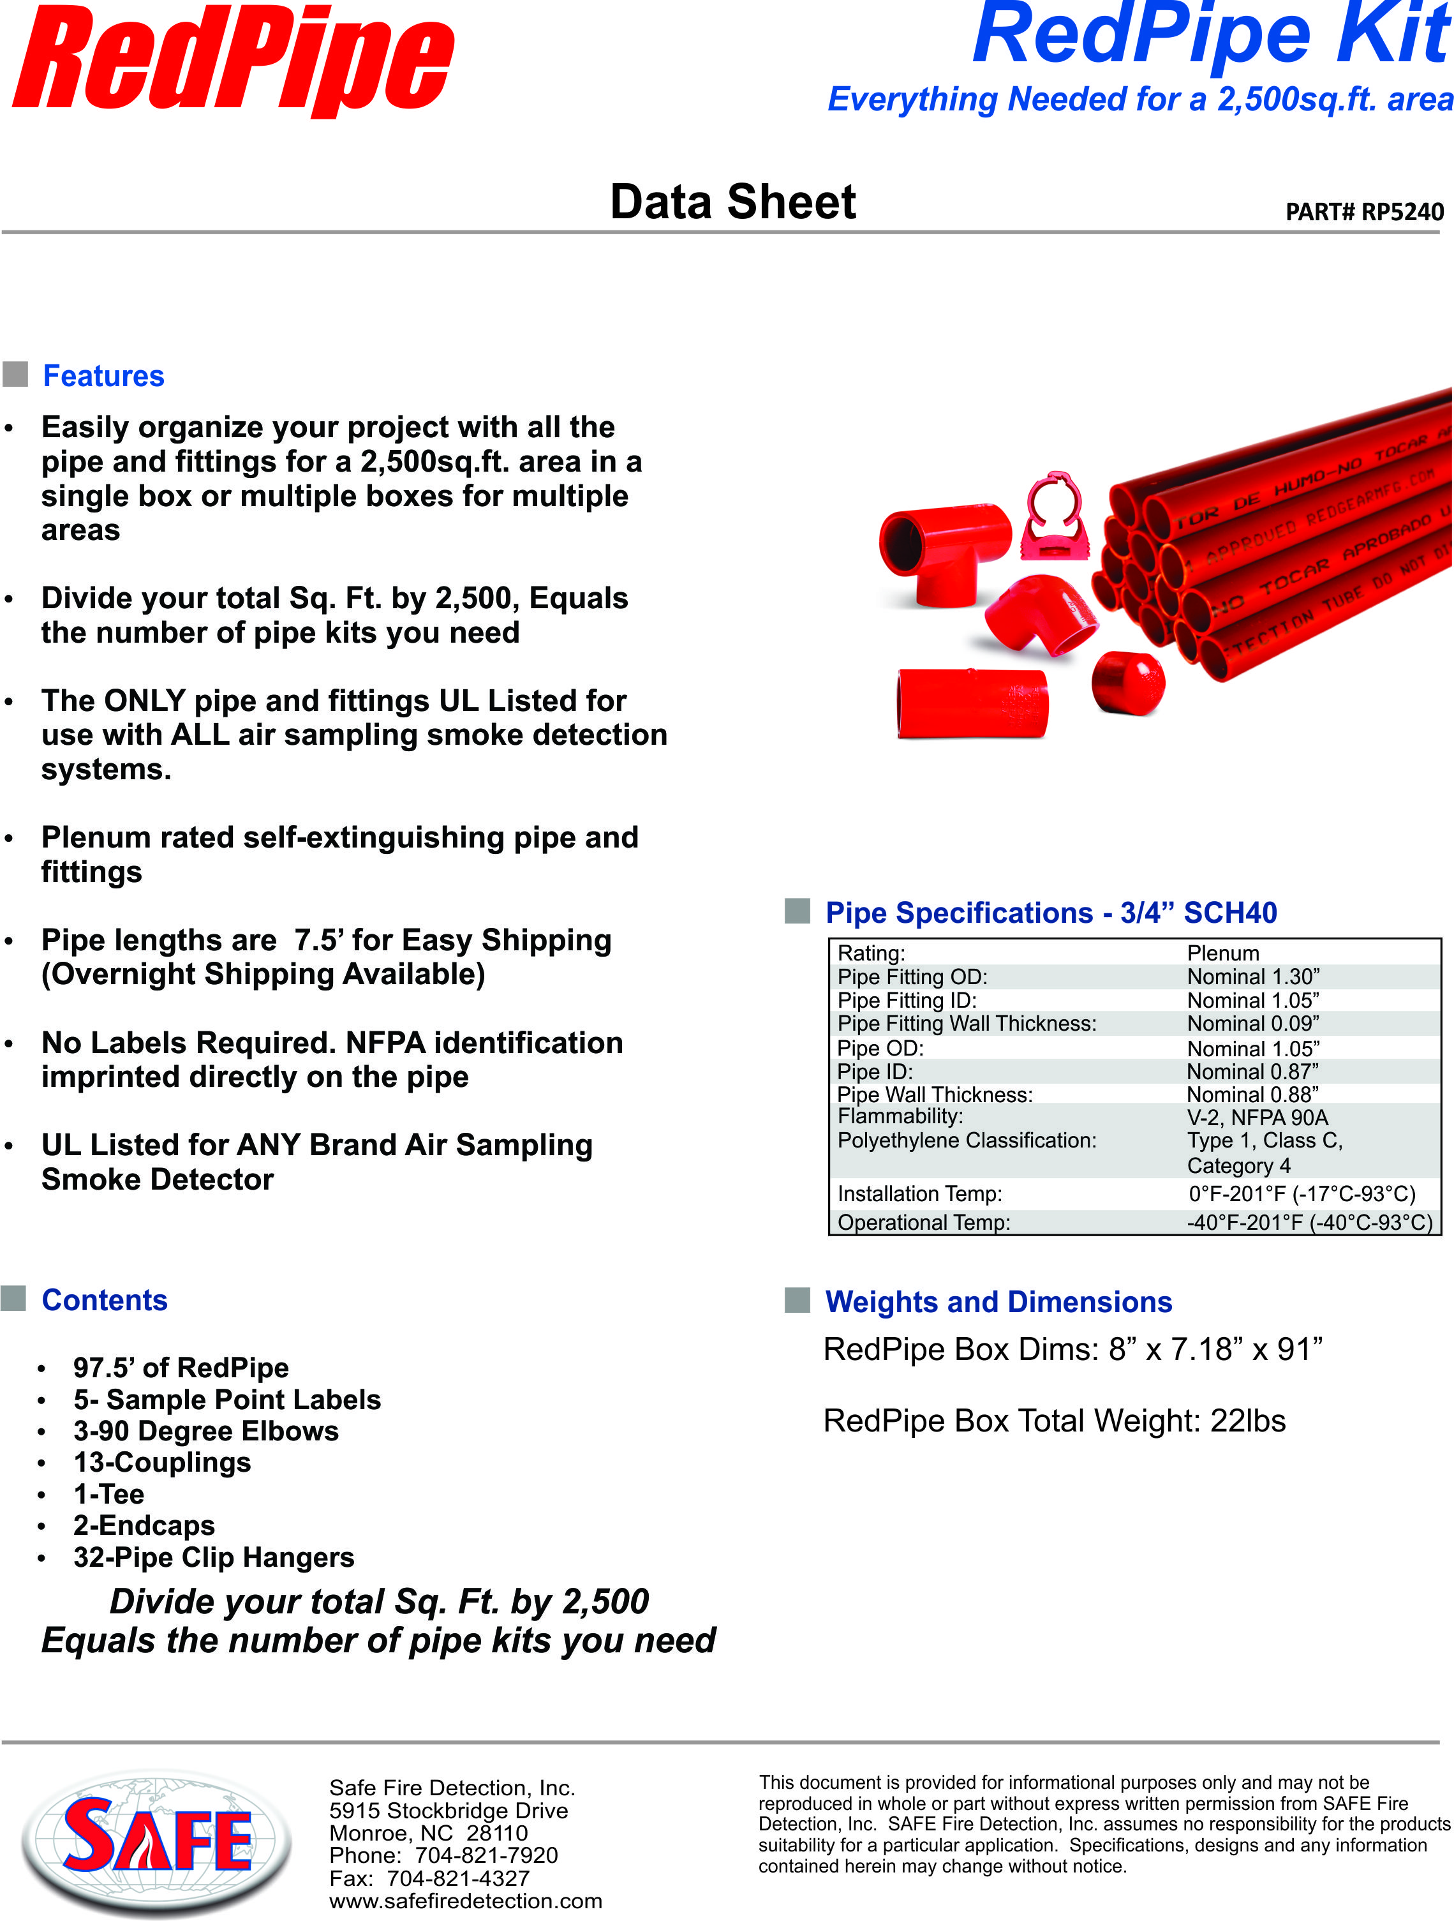
Notes:
Easily organize your project with all the pipe and fittings for a 2,500sq.ft. area in a single box or multiple boxes for multiple areas
Divide your total Sq. Ft. by 2,500, Equals the number of pipe kits you need
The ONLY pipe and fittings UL Listed for use with ALL air sampling smoke detection systems.
Plenum rated self-extinguishing pipe and fittings
Pipe lengths are 7.5’ for Easy Shipping (Overnight Shipping Available)
No Labels Required. NFPA identification imprinted directly on the pipe
UL Listed for ANY Brand Air Sampling Smoke Detector

Slide 10


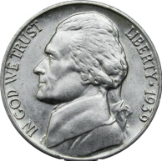
And All for a Nickel a Sq. Foot
In Stock – Ready To Ship
It Doesn’t Get Any Easier!!!
Notes:
The easiest pipe take off ever!! Simply divide your total square footage by 2500 = the number of kits you need and all for $125.00. If you as a company standardize on Redpipe we will give them to you for $100 each
And all for a Nickel a square foot

Slide 11
Notes:
Thank you for your time. If you have any questions just please feel free to ask ☺
DO NOT OFFER OR GIVE A COPY OF ANY PART OF THIS PRESENTATION TO ANYONE. THIS IS AN INTERNAL DOCUMENT.
Q: Can you use Redpipe on Vesda? A: Yes, Redpipe is UL listed for ANY UL listed air sampling smoke detector.
Q: If they ask you about Blazemaster. Vesda pipe is private labeled Blazemaster.
Blazemaster has the following UL listings which are tested as sprinkler pipes with water in them. Blazemaster is not specifically listed for use with air sampling smoke detectors, but instead is listed as an accessory on a Vesda system.
BlazeMaster is UL Listed (Underwriters Laboratories), C-UL and ULC
UL 1821 - Thermoplastic Sprinkler Pipe and Fittings for Fire Protection Service UL 1887 - Standard for Safety Fire Test of Plastic Sprinkler Pipe for Visible Flame and Smoke Characteristics
End the discussion with a positive: Redpipe is UL listed for ANY UL listed air sampling smoke detector.
Q: What is in a Redpipe Kit. A: Please refer to slide #9

