Slide 1


Slide 2








Very Early Warning
Fire and Smoke Detector
Early Warning
Smoke Detector
IR3 and UVIR Flame Detector
Digital Linear Heat Detector
www.safefiredetection.com
Air Sampling
Pipe and Fittings
Linear Heat Detection
Installation Supplies
Notes:
Hi my name is XXXXXXXXXXX. I am here to discuss air sampling smoke detection for Safe Fire Detection. Safe manufactures specialty detection products including air sampling smoke and fire detectionand , Safecable linear heat detection, safe flame flame detectors, Redpipe air sampling pipe and fittings finally redgear linear heat detection custom installation materials.

Slide 3
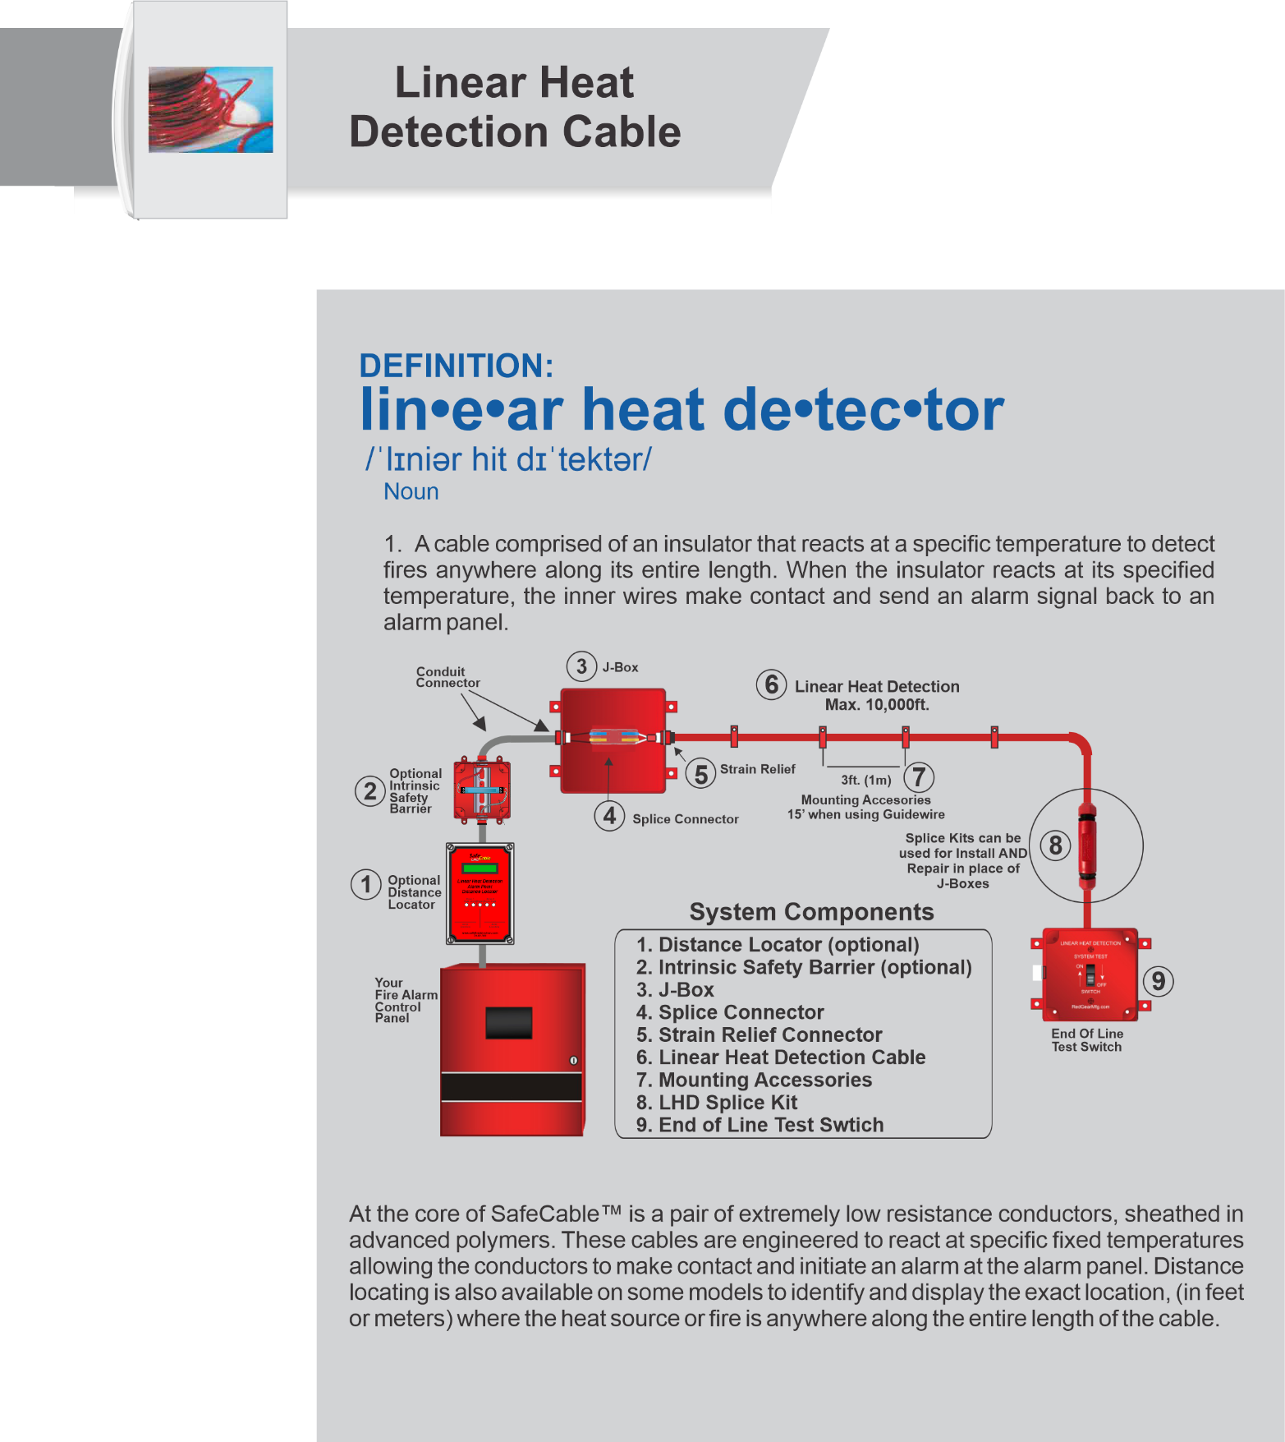
Definition
Notes:
Short version: What is air sampling? (pause) Air sampling smoke detectors use a powerful fan, located in the detector, to draw air back from the room where sample holes are located in the same place traditional smoke detectors would have been. This is called active smoke detection, along with a highly sensitive detector inside the unit to give you the earliest possible alarm. (See long version below if needed) Long version: Let’s start by taking a minute to learn what air sampling smoke detection is. Traditionally smoke detection has been done by having a fire alarm panel on the wall, then conduit would come out of the top of the panel and run throughout the room, stopping and adding a junction box every 30x30 where you would mount a smoke detector. Then you would wait for smoke to find it’s way to the smoke detector to alarm. That is called passive smoke detection. Back in the 70’s, they found it was more efficient to create an active smoke detection system, so you didn’t have to wait for smoke to hopefully find it’s way to the smoke detector. That was the beginning of air sampling smoke detection. Now you have an air sampling smoke detector mounted to the wall, which has a fan in it that draws air back to the detector, through pipe, that is ran throughout the room, similar to how the old pipe was ran. But now you have no wire inside, and where each smoke detector use to be is now a sample hole. Now you don’t have to wait for smoke to rise to the smoke detector, as the fan is pulling air from each of the smoke detector locations back to the detector enclosure. Which has an ultrasentive sensor inside to analyse the air as it comes back, alarming much faster and at an earlier level than conventional smoke detectors.

Slide 4

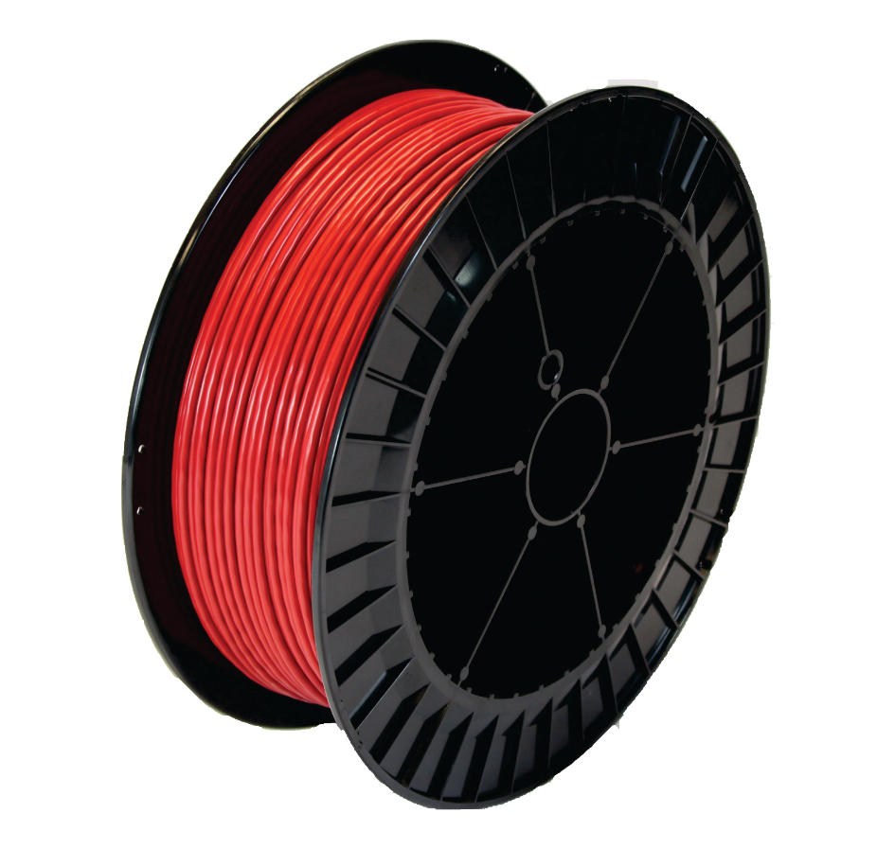



Up To
10,000 Linear Feet
Per Zone
Low Cost
Linear Heat
Detection Cable

Slide 5


Slide 6

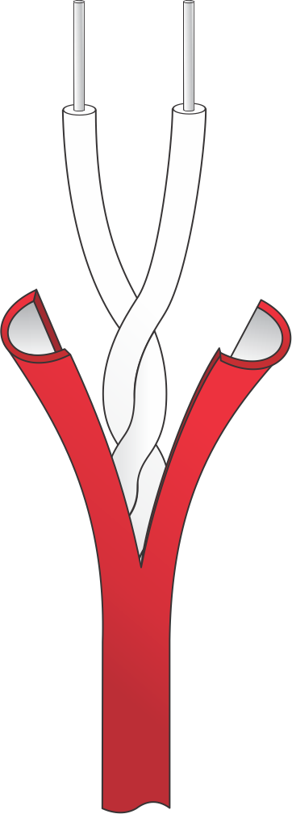
Advanced cable design
Trimetalic core
Lower resistance
High conductivity
Corrosion resistance
Greater flexibility for easier installation
For use on ANY fire alarm panel or monitor module
Notes:
Hybrid offers the earliest detection possible for both smoke and fire giving you hours of advance warning to address the problem at it’s earliest stage before it has a chance to propagate into a situation which could cause damage or even business interruption.

Slide 7
Advanced cable design
10,000ft continuous run length
Lower material cost
Reduce installation time
Use YOUR panel
Notes:
Hybrid offers the earliest detection possible for both smoke and fire giving you hours of advance warning to address the problem at it’s earliest stage before it has a chance to propagate into a situation which could cause damage or even business interruption.

Slide 8
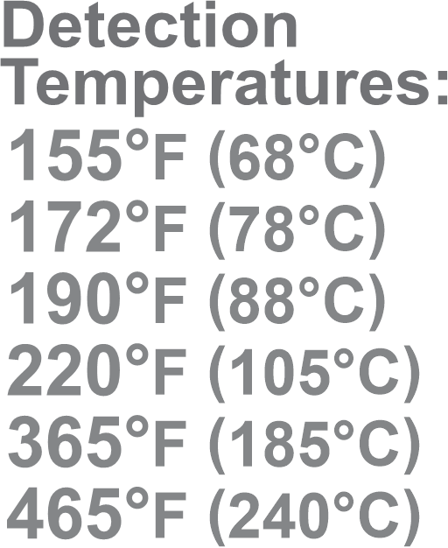
Temperatures and Coatings
Nylon - UV protected for outdoor applications and extra durable for harsh industrial environments.
Polypropylene – For chemically harsh and caustic environments such as wet benches.
GuideWire – For spanning distances up to 250 ft. (76m) with supports every 15 ft. (4.6m).
Notes:
Hybrid offers the earliest detection possible for both smoke and fire giving you hours of advance warning to address the problem at it’s earliest stage before it has a chance to propagate into a situation which could cause damage or even business interruption.

Slide 9
Temperatures and Spacing
Temperature Rating | UL, C-UL-US | FM
155°F (68°C) | 35’ (10.7m) | 30’ (9.1m)
172°F (78°C) | 35’ (10.7m) | 30’ (9.1m)
190°F (88°C) | 35’ (10.7m) | 30’ (9.1m)
220°F (105°C) | 35’ (10.7m) | 25’ (7.6m)
365ºF (185ºC) | 35’ (10.7m) | 25’ (7.6m)
Area Spacing
.7x
17’6” (5.3m)
35’ (10.7m)
Notes:
Hybrid offers the earliest detection possible for both smoke and fire giving you hours of advance warning to address the problem at it’s earliest stage before it has a chance to propagate into a situation which could cause damage or even business interruption.

Slide 10
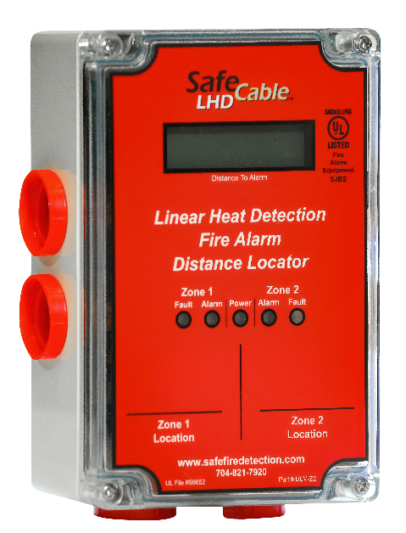
Distance locating
1 or 2 zone detection
Cross zoning configuration
Find the location of the fire
Class A or Class B
Notes:
Hybrid offers the earliest detection possible for both smoke and fire giving you hours of advance warning to address the problem at it’s earliest stage before it has a chance to propagate into a situation which could cause damage or even business interruption.

Slide 11
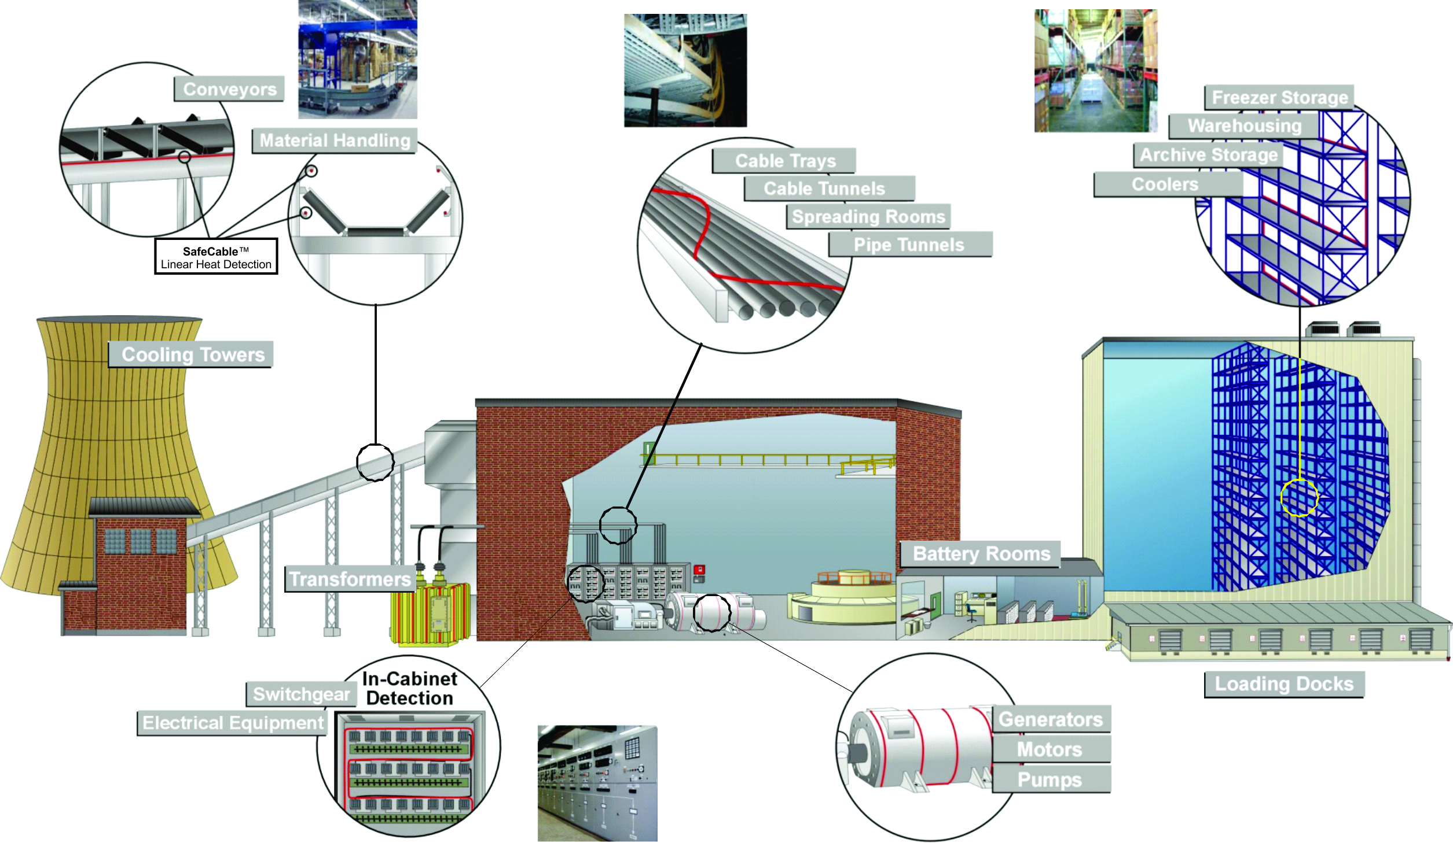
Applications
Notes:
Hybrid offers the earliest detection possible for both smoke and fire giving you hours of advance warning to address the problem at it’s earliest stage before it has a chance to propagate into a situation which could cause damage or even business interruption.

Slide 12
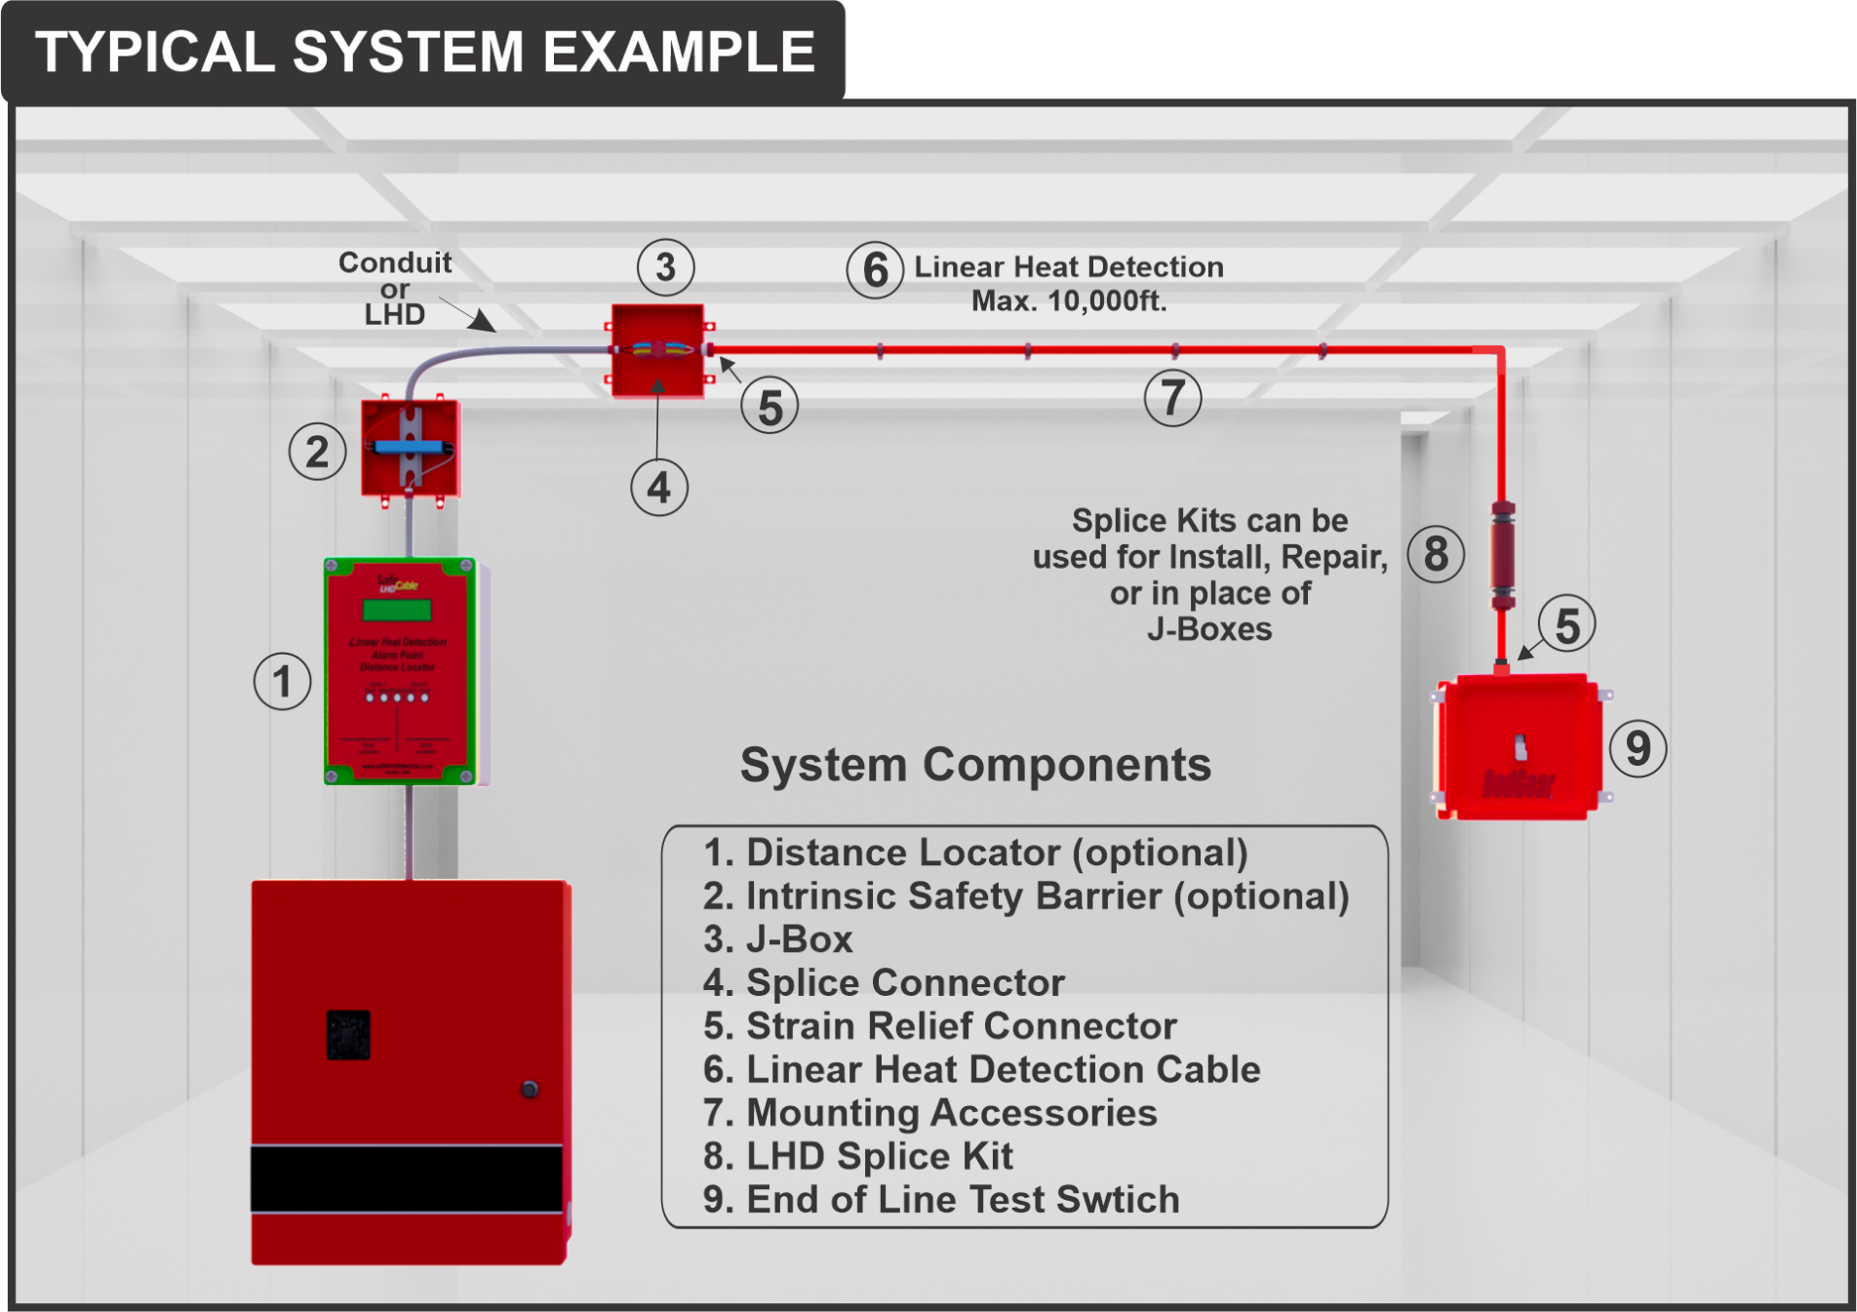
Notes:
Before we talk about installing a system, we need to understand the different parts of a early warning air sampling system. Here you will see the individual basic parts are labeled (review all parts with the audience). Of course systems can get much more complicated, but these are the basic parts of every system.

Slide 13

Notes:
Safe is the only company that manufactures our own installation materials. The installation materials for the air sampling product line come under our product name RedPipe. Redpipe is the only UL listed pipe and fittings approved specifically for use with air sample smoke detection systems. And can be used on ANY air sampling system. Blazermaster is UL listed as a sprinkler pipe, not an air sampling pipe.

Slide 14
Notes:
Besides Redpipe being the only UL approved pipe and fittings specifically listed and approved for use with any air sampling detector, Redpipe is approved for plenum spaces and is preprinted with NFPA required text in both English and Spanish so pipe labels are no longer needed. RedPipe comes in both 7.5 and 15ft lengths allowing for freight or overnight shipments of the 7.5 foot lengths.

Slide 15
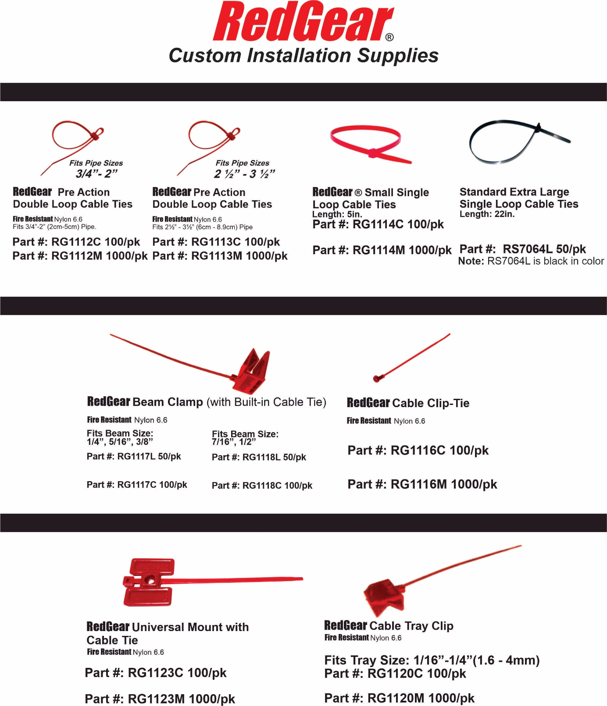

Slide 16
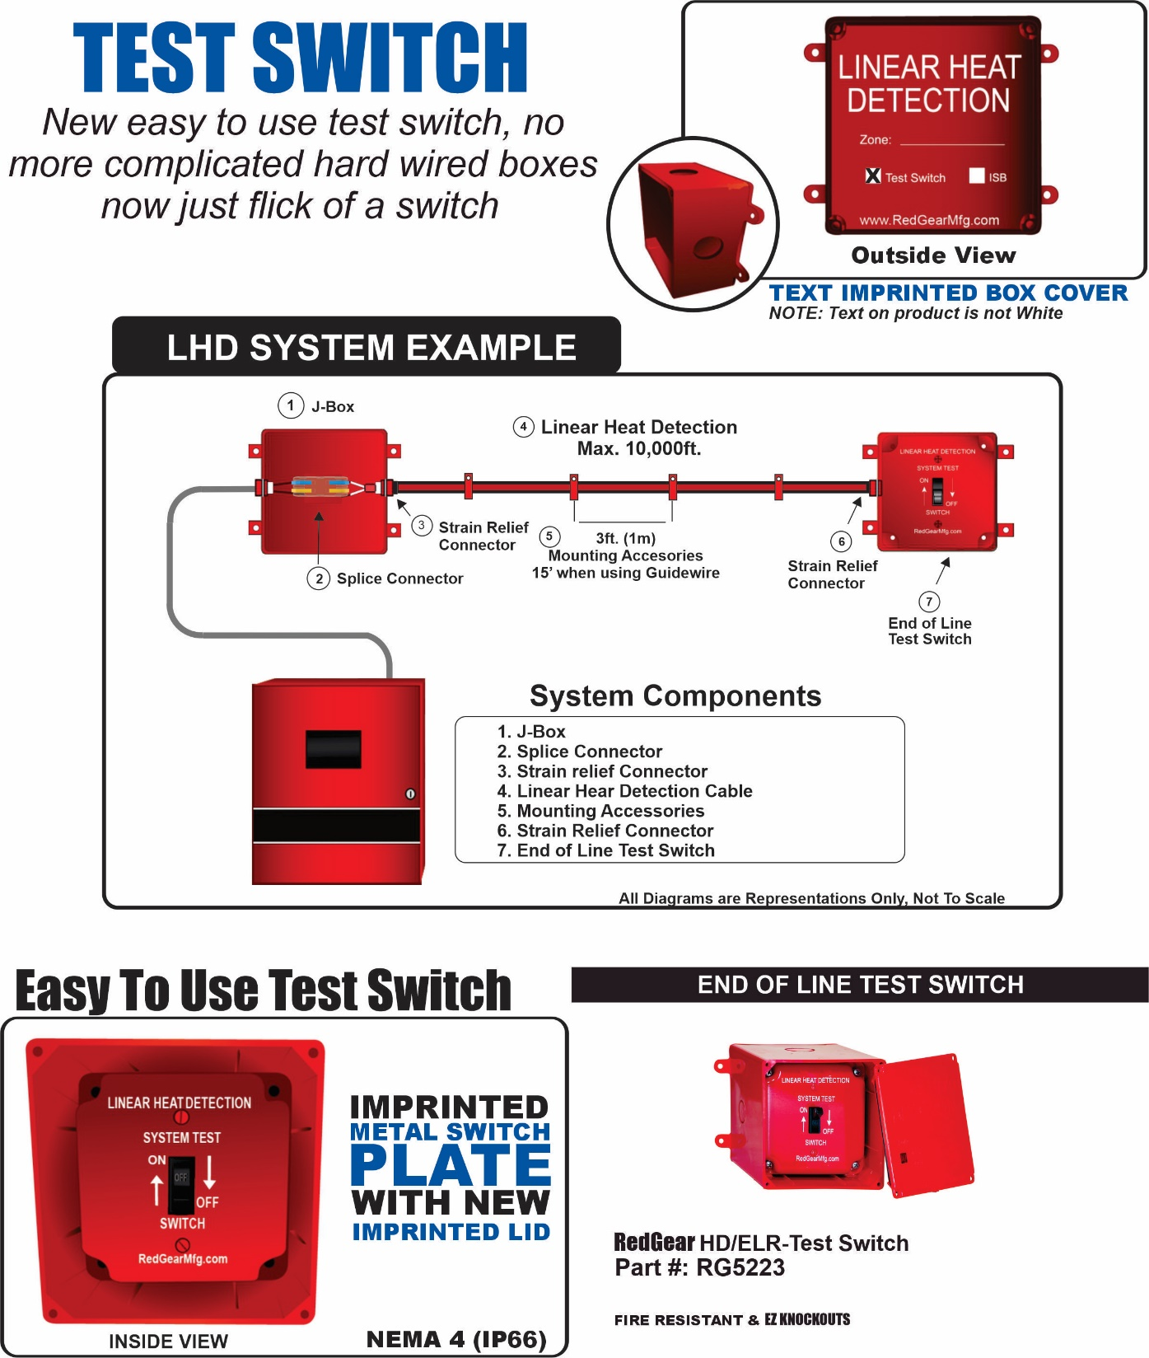

Slide 17
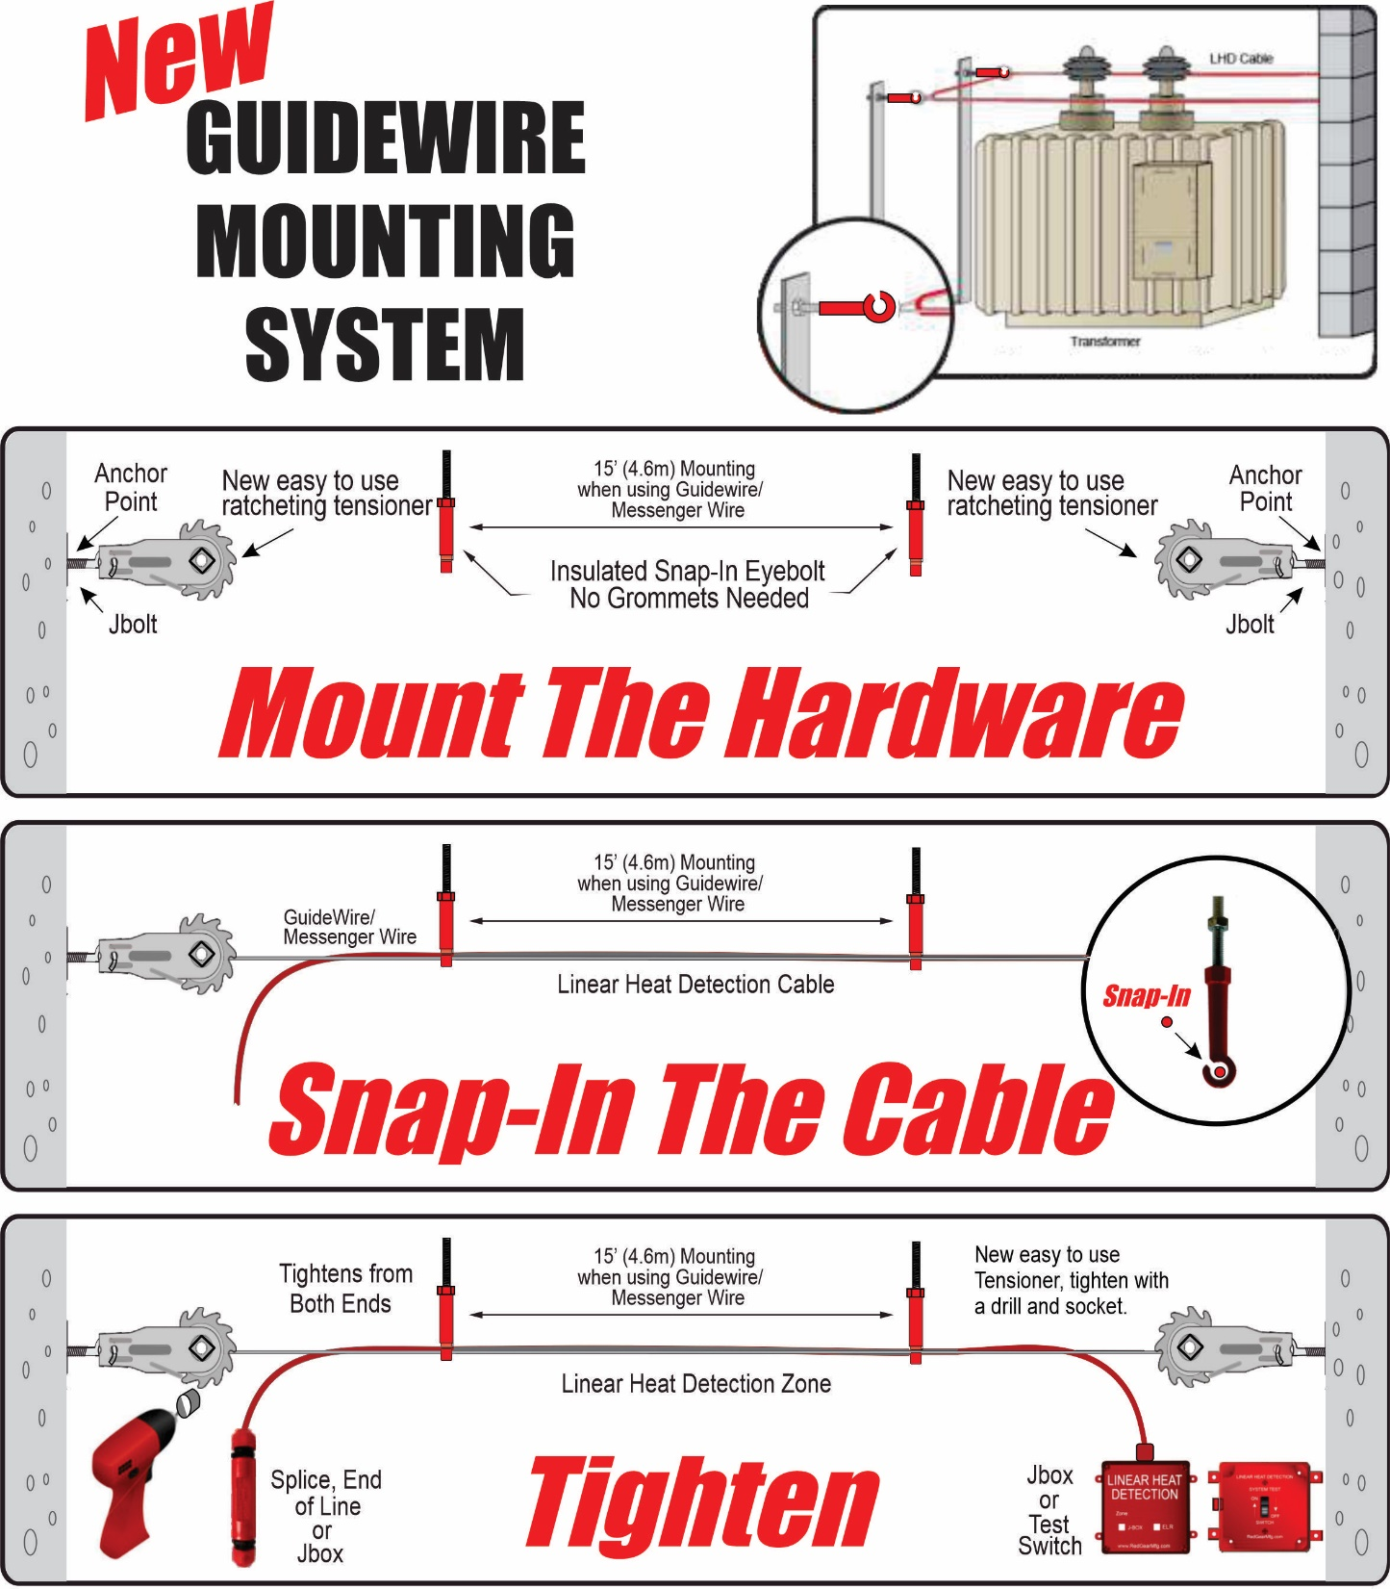

Slide 18
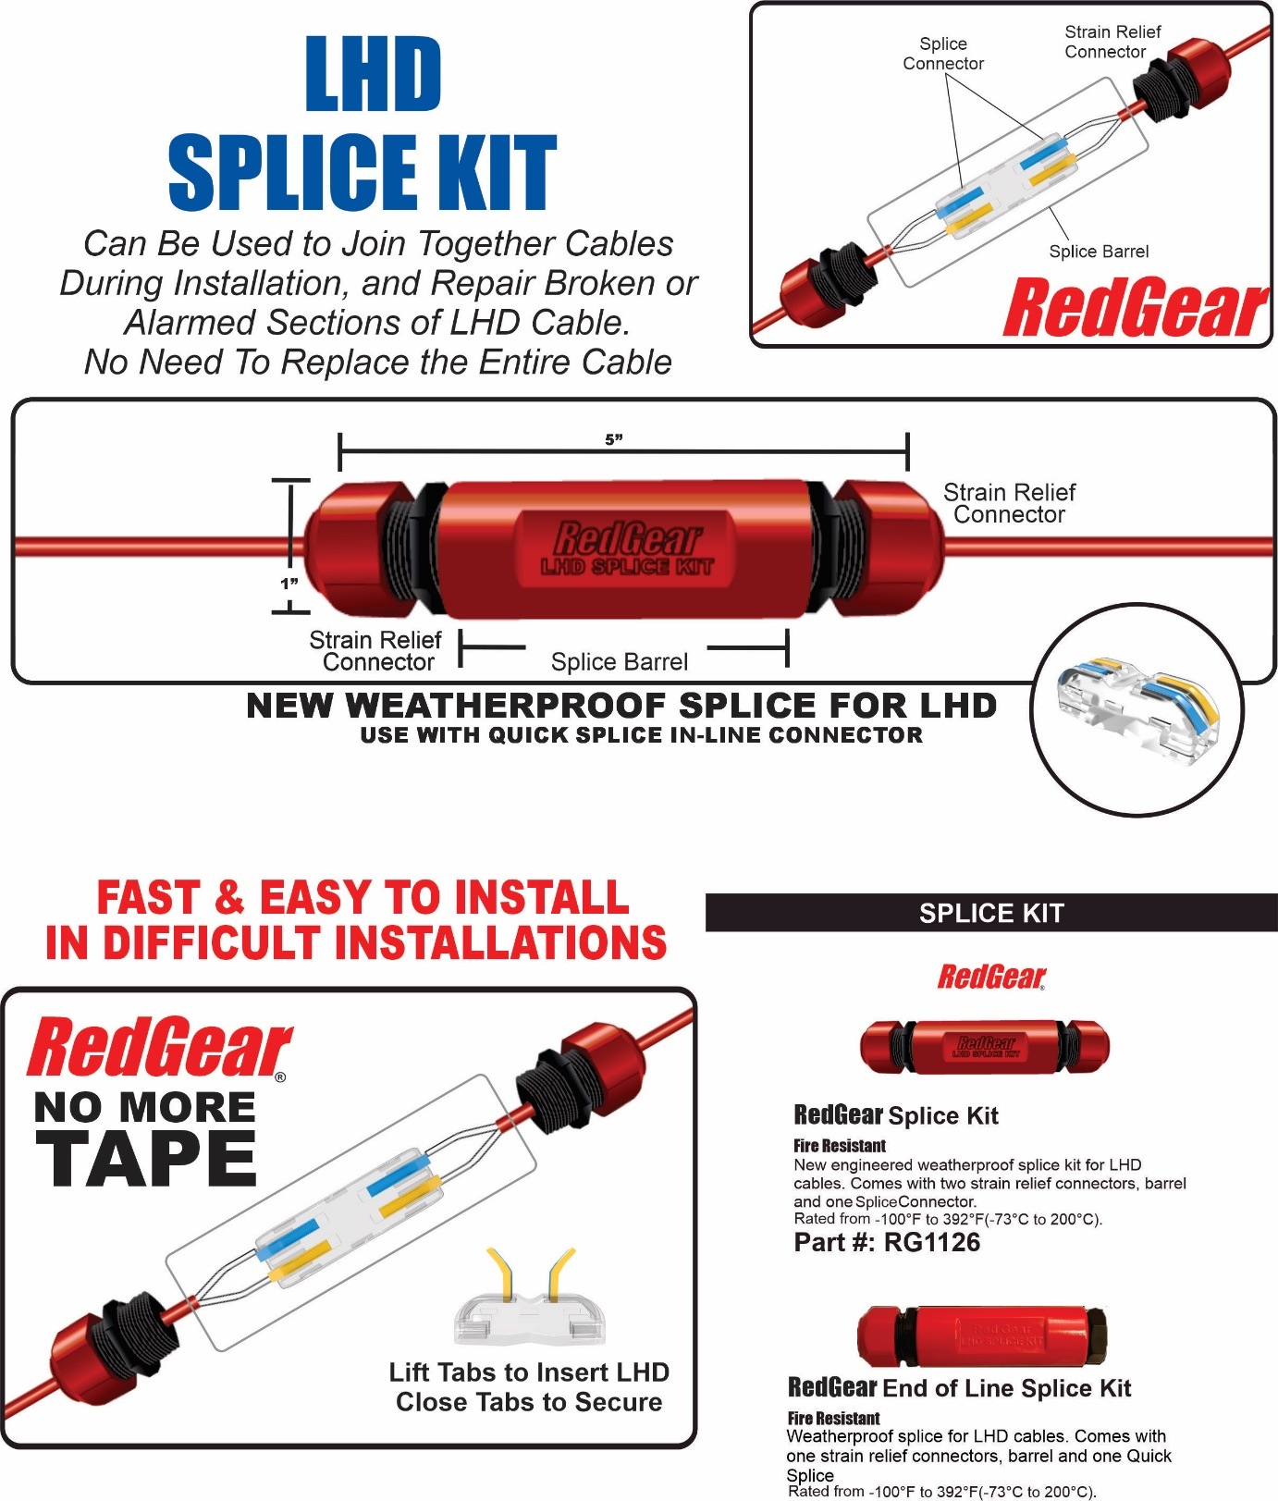
Notes:
A complete line of RedPipe fittings and accessories are available in our RedPipe catalog available online or by request.

Slide 20
Very Early Warning
Fire and Smoke Detector
Early Warning
Smoke Detector
IR3 and UVIR Flame Detector
Digital Linear Heat Detector
www.safefiredetection.com
Air Sampling
Pipe and Fittings
Linear Heat Detection
Installation Supplies
Notes:
Hi my name is XXXXXXXXXXX. I am here to discuss air sampling smoke detection for Safe Fire Detection. Safe manufactures specialty detection products including air sampling smoke and fire detectionand , Safecable linear heat detection, safe flame flame detectors, Redpipe air sampling pipe and fittings finally redgear linear heat detection custom installation materials.

