Slide 1


Notes:
Introductions

Slide 2






Very Early Warning
Fire and Smoke Detector
Early Warning
Smoke Detector
IR3 and UVIR Flame Detector
Digital Linear Heat Detector
www.safefiredetection.com
Air Sampling
Pipe and Fittings
Linear Heat Detection
Installation Supplies
Notes:
Hi my name is XXXXXXXXXXX. I am here to talk about Flame detection for Safe Fire Detection. Safe manufactures specialty detection products including air sampling smoke and fire detectionand , Safecable linear heat detection, safe flame flame detectors, Redpipe air sampling pipe and fittings finally redgear linear heat detection custom installation materials.

Slide 3
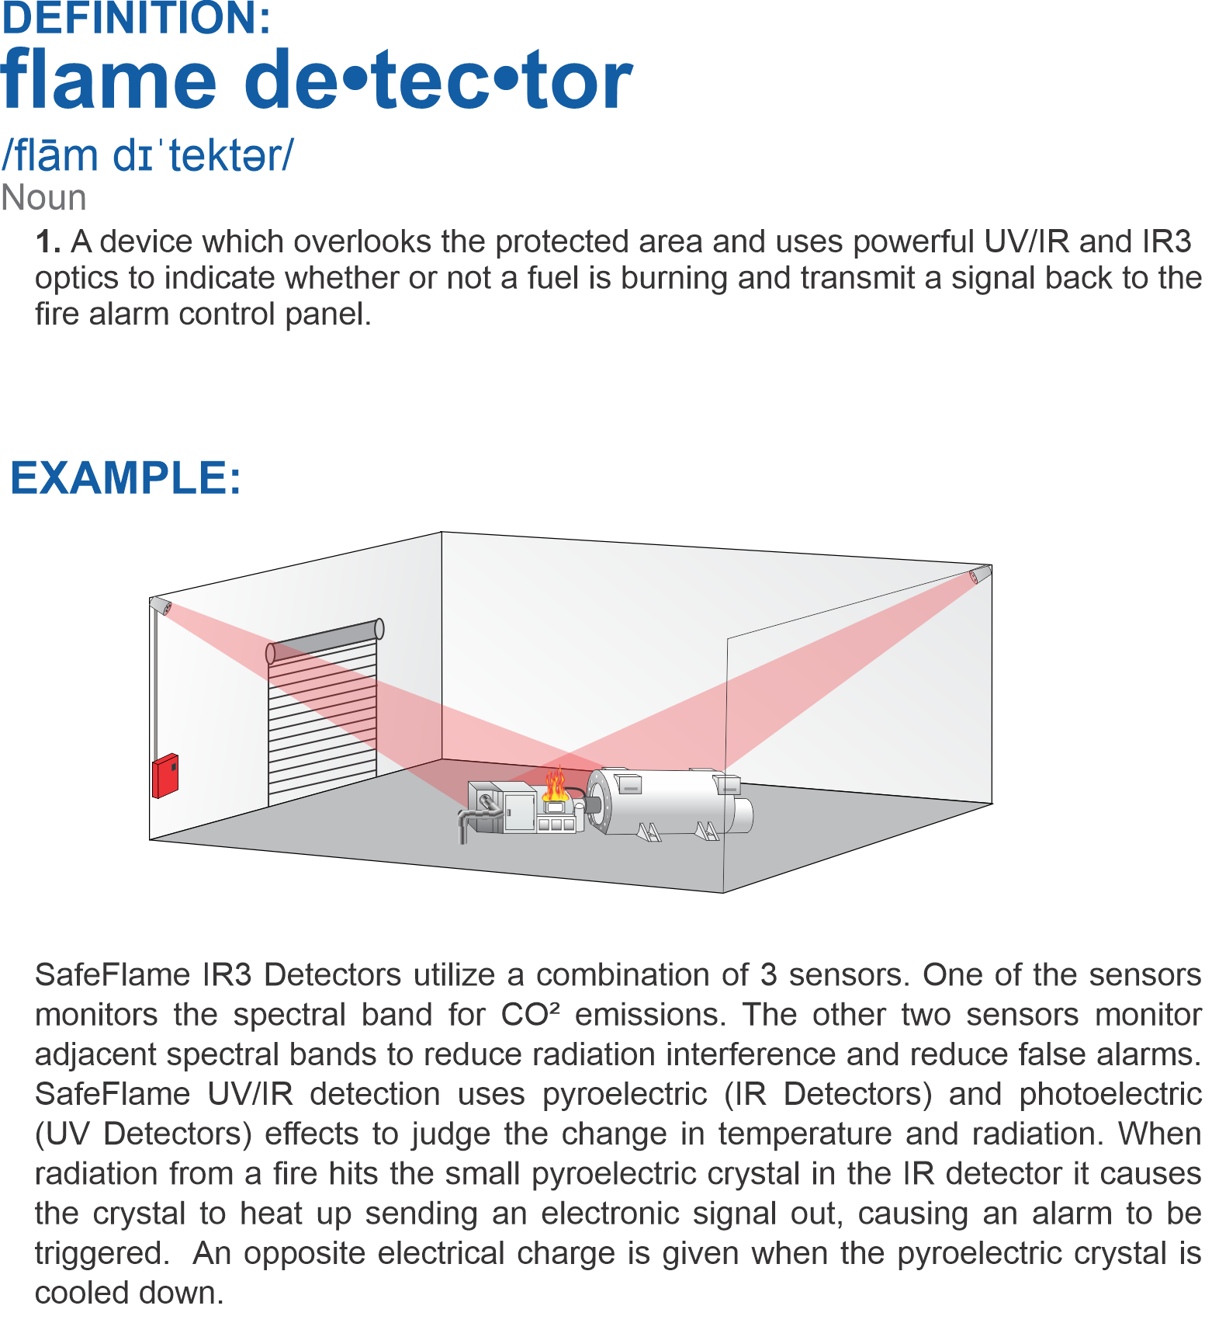
Notes:
Flame detection is a device wich overlooks the protected area and uses powerful UVIR or IR3 optics to indicate whether or not a fuel is burning and transmit a signal back to the fire alarm control panel

Slide 4
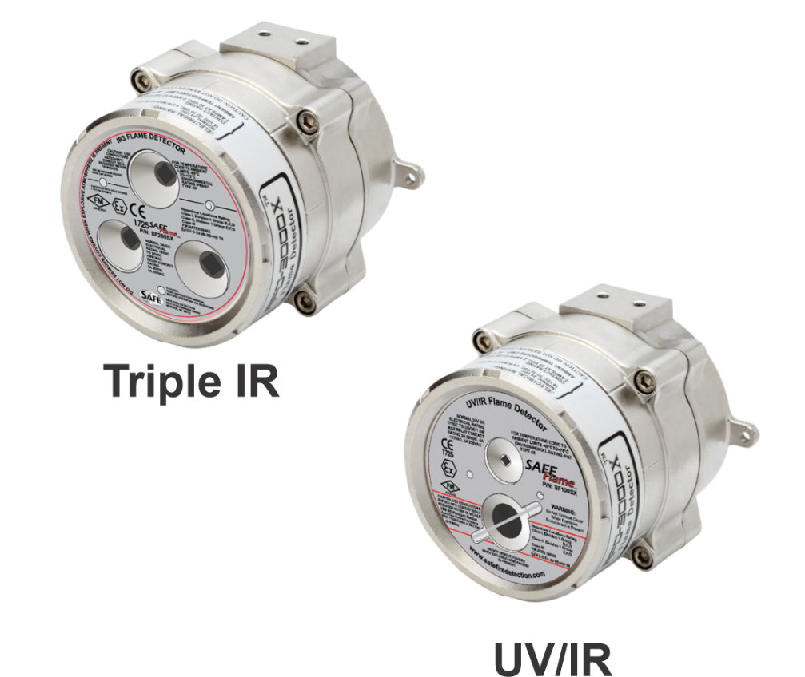



The Latest in UV/IR and IR3 Optical Flame Detection
Notes:
Finally there is affordable flame detection for your everyday project. SafeFlame flame detectors are easy to use, and compatible with all fire alarm panels.

Slide 5


Slide 6

Types of Flame detection
UVIR and how it works
IR3 and how it works
Both available in EX-Proof and Normal
Notes:
Hybrid offers the earliest detection possible for both smoke and fire giving you hours of advance warning to address the problem at it’s earliest stage before it has a chance to propagate into a situation which could cause damage or even business interruption.

Slide 7
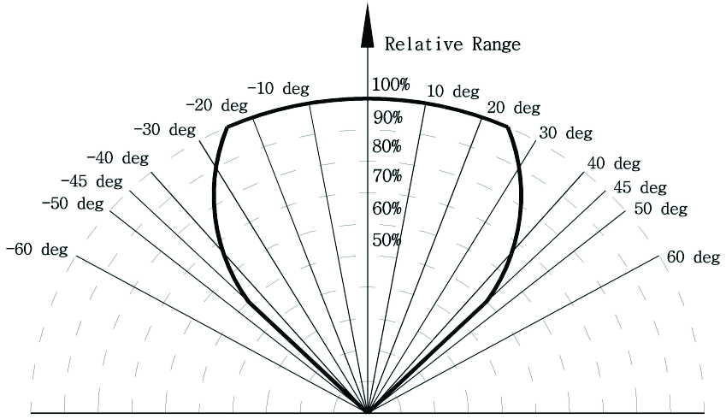
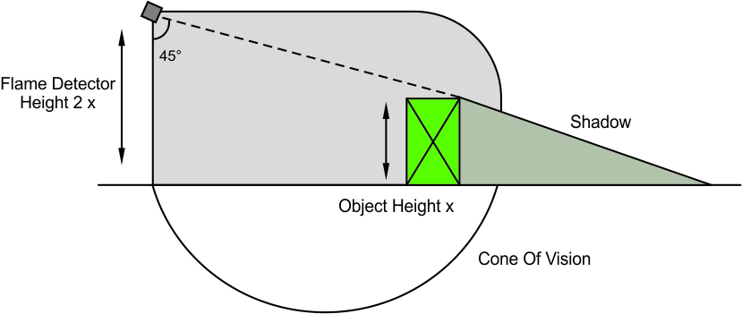
Area of Coverage
Full Response to Flames
90 Degree Field of View
Cone Of Vision
Up to 200ft of Coverage
Notes:
Hybrid offers the earliest detection possible for both smoke and fire giving you hours of advance warning to address the problem at it’s earliest stage before it has a chance to propagate into a situation which could cause damage or even business interruption.

Slide 8
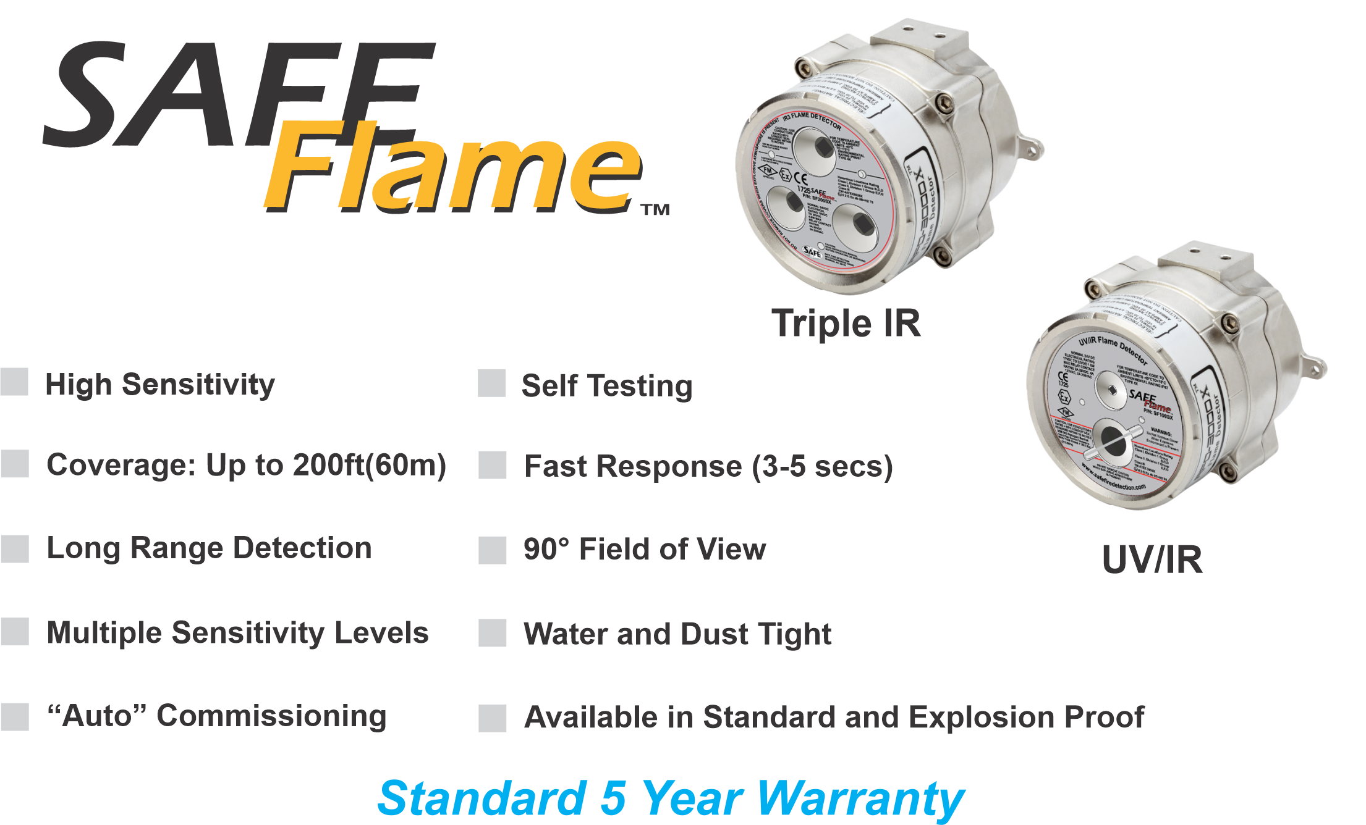
Notes:
Hybrid offers the earliest detection possible for both smoke and fire giving you hours of advance warning to address the problem at it’s earliest stage before it has a chance to propagate into a situation which could cause damage or even business interruption.

Slide 9
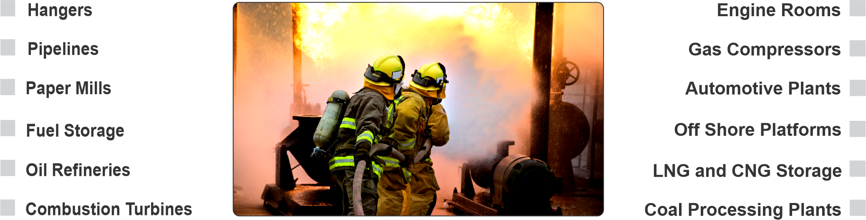
Notes:
No matter what your application or individual detection needs are, the Hybrid, ProPoint, or CCD detectors can solve most any project requirement you have.

Slide 10
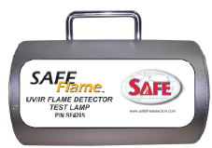
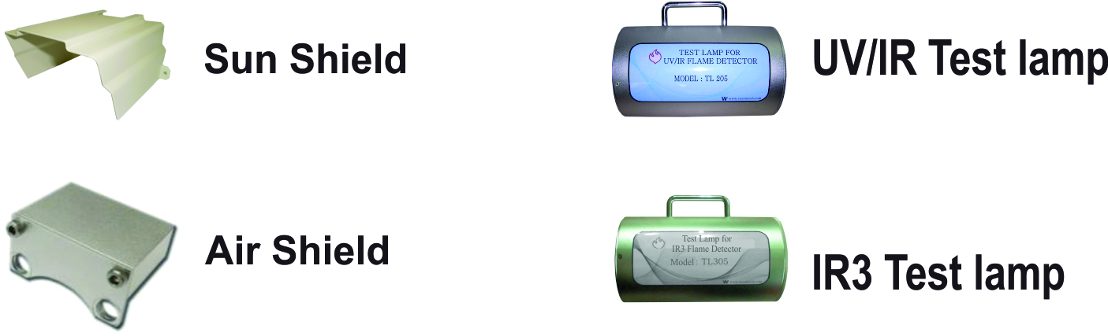
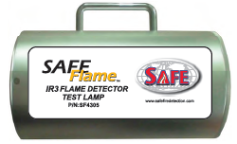
Accessories
Notes:
Hybrid offers the earliest detection possible for both smoke and fire giving you hours of advance warning to address the problem at it’s earliest stage before it has a chance to propagate into a situation which could cause damage or even business interruption.

Slide 11
Very Early Warning
Fire and Smoke Detector
Early Warning
Smoke Detector
IR3 and UVIR Flame Detector
Digital Linear Heat Detector
www.safefiredetection.com
Air Sampling
Pipe and Fittings
Linear Heat Detection
Installation Supplies
Notes:
Hi my name is XXXXXXXXXXX. I am here to talk about Flame detection for Safe Fire Detection. Safe manufactures specialty detection products including air sampling smoke and fire detectionand , Safecable linear heat detection, safe flame flame detectors, Redpipe air sampling pipe and fittings finally redgear linear heat detection custom installation materials.

Slide 12
Notes:
Introductions

